Slide 2
THE BRINK’S COMPANY
Virginia Commonwealth University
Nick DeRobertis | Corbin Fox | Kellie Masters | Chris Prompovitch

Slide 3
Investment Summary
Brink’s industry has a challenging outlook.
Brink’s underperforms relative to its competitors.
The company is exposed to substantial risks that management does not fully address.
Fundamental analysis has deemed Brink’s stock overvalued.
Key Points
Business Overview
Risk Analysis
Financial Analysis
Conclusion

Slide 4
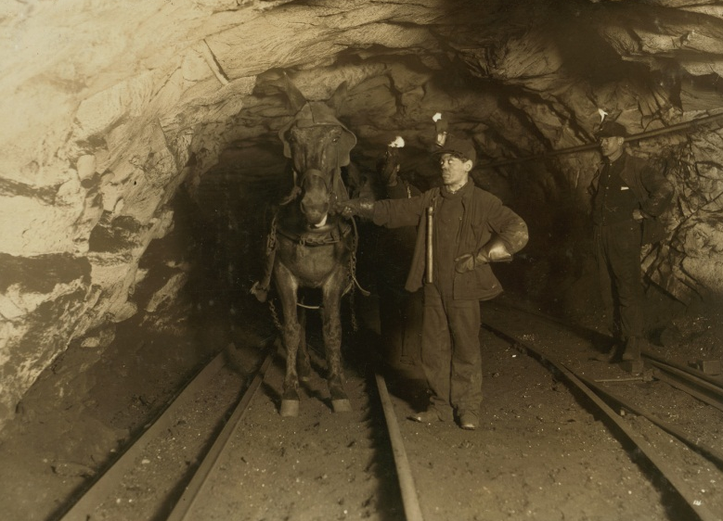
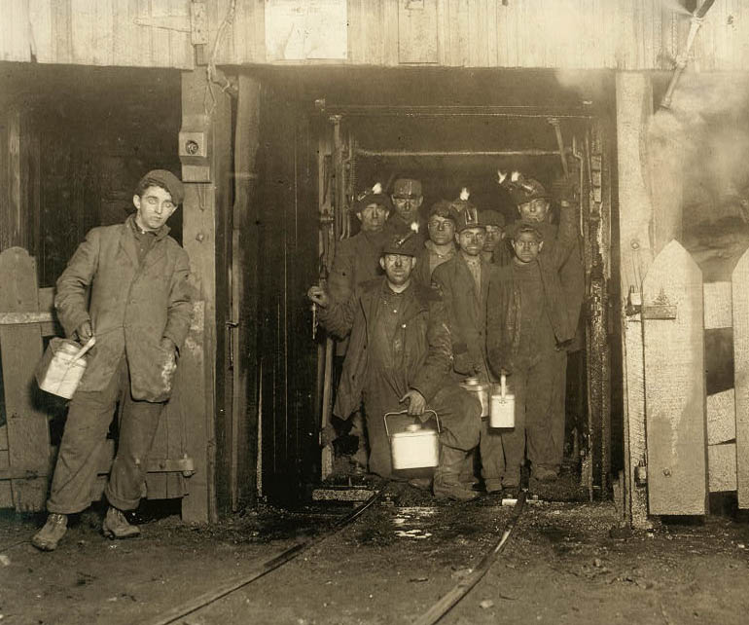
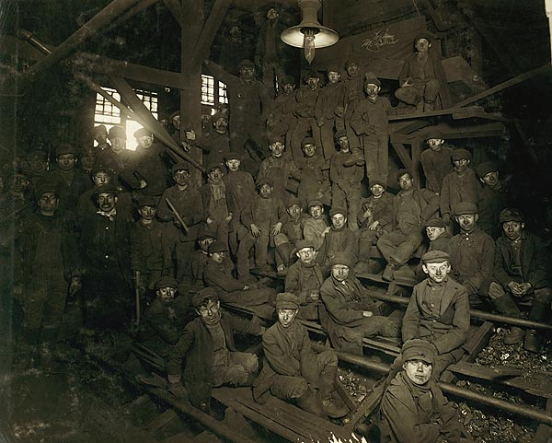
Company Background
1859 – Pittston Coal Company
1999 – Divested coal business
2003 – Name changed to Brink’s
Business Description
Industry Overview
Competitor Analysis
Key Points
Business Overview
Risk Analysis
Financial Analysis
Conclusion

Slide 5
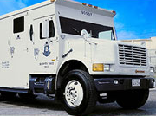
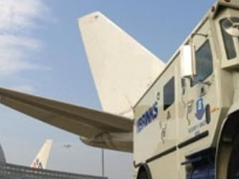
Business Segments
Percentage of 2012 revenue
$2.4 billion
Cash-in-Transit
ATM Services
Security
Services
9%
$1.4 billion
Global Services
Cash Management Services
High-Value
Services
36%
Core Services
55%
$0.3 billion
Guarding Services
Airport Security
Business Description
Industry Overview
Competitor Analysis
Key Points
Business Overview
Risk Analysis
Financial Analysis
Conclusion

Slide 6
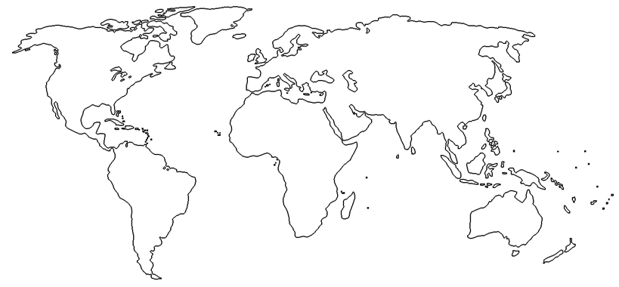
Geographic Segments
25%
30%
4%
41%
Business Description
Industry Overview
Competitor Analysis
Key Points
Business Overview
Risk Analysis
Financial Analysis
Conclusion

Slide 7
Home Security Spinoff
Percentage of total ($337 Million)
Percentage of total ($3,219 Million)
Industry Overview
Business Description
Competitor Analysis
Key Points
Business Overview
Risk Analysis
Financial Analysis
Conclusion

Slide 8
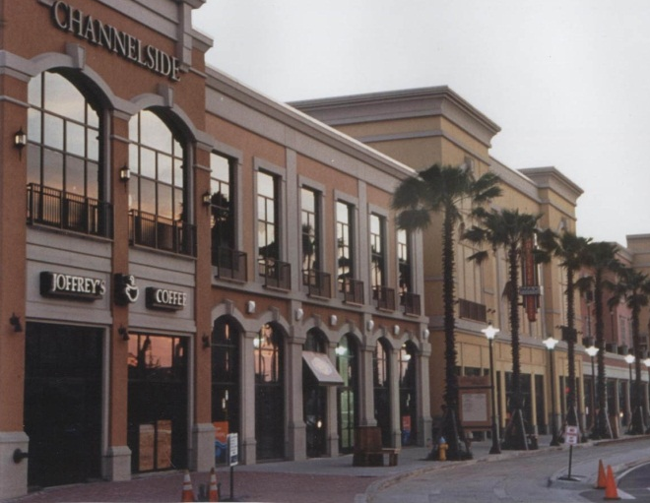
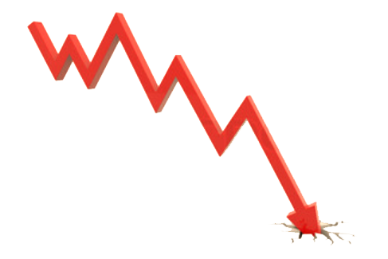
Industry Dynamics
Retail Centers
Banks
Other Retail Businesses
Business Description
Industry Overview
Competitor Analysis
Key Points
Business Overview
Risk Analysis
Financial Analysis
Conclusion

Slide 9
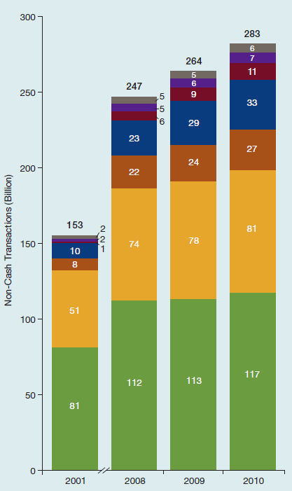
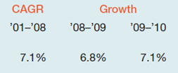
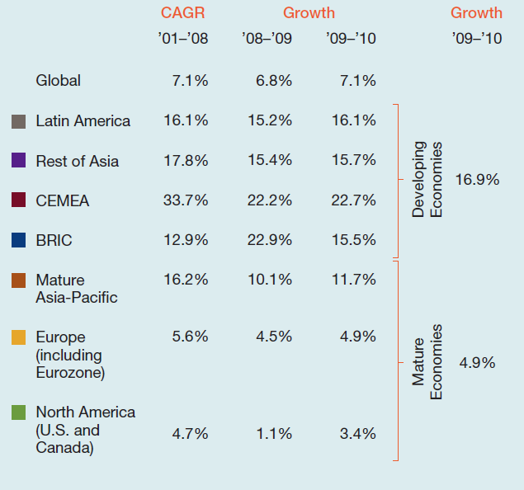
Key External Driver
Weighted Average
’01–’10
7.07%
Business Description
Industry Overview
Competitor Analysis
Key Points
Business Overview
Risk Analysis
Financial Analysis
Conclusion

Slide 10
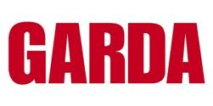
Competitive Landscape
Brink’s
Business Description
Industry Overview
Competitor Analysis
Key Points
Business Overview
Risk Analysis
Financial Analysis
Conclusion

Slide 11
Investment Summary
Brink’s industry has a challenging outlook.
Brink’s underperforms relative to its competitors.
The company is exposed to substantial risks that management does not fully address.
Fundamental analysis has deemed Brink’s stock overvalued.
Key Points
Business Overview
Risk Analysis
Financial Analysis
Conclusion

Slide 12
Risk Analysis
INDUSTRY RISKS
1. Segment Failure Risk
2. New Entrant Risk
9
OPERATIONAL RISKS
3. Stolen Consumer Valuables
4. Failure of IT Systems
5. Reputation Risk
6. Previous Operations Litigations
7
PROBABILITY
10
REGULATORY RISKS
7. Industry Regulation Change
8. Tax Regulation Change
2
3
5
8
6
4
1
FINANCIAL RISKS
9. Currency Exchange Risk
10. Unfunded Liability Risk
SEVERITY
Key Points
Business Overview
Risk Analysis
Financial Analysis
Conclusion
Notes:
The industry Brink’s is placed in poses risks to their sustainability in the future. The macro risk that is created by an unstable economic environment, and a potential decrease in demand, opens Brink’s up to the possibility of segment failure. The company also faces much competition. For example, Brink’s management identified Garda as a low-cost competitor that has taken market share from them. Management is reluctant to mitigate this risk and so it remains a threat. Also, there is a risk of new entrants joining the industry which could put even more pressure on Brink’s.

Slide 13
Investment Summary
Brink’s industry has a challenging outlook.
Brink’s underperforms relative to its competitors.
The company is exposed to substantial risks that management does not fully address.
Fundamental analysis has deemed Brink’s stock overvalued.
Key Points
Business Overview
Risk Analysis
Financial Analysis
Conclusion

Slide 14
Revenue Growth
Financial Statements
Valuation
Key Points
Business Overview
Risk Analysis
Financial Analysis
Conclusion
Picture relating to hedging currency exchange risk

Slide 15
Cost of Goods Sold & Margins
Financial Statements
Valuation
Key Points
Business Overview
Risk Analysis
Financial Analysis
Conclusion

Slide 16
Net Income
 | 2007 | 2008 | 2009 | 2010 | 2011 | 2012E
Total Debt ($ millions) | 98.7 | 188.6 | 195.6 | 389.2 | 315.6 | 328.2
Income Tax Rate | 37.0% | 23.6% | -36.7% | 48.1% | 38.0% | 23.8%
Earnings of Discontinued Ops. ($ millions) | 58.9 | 51.5 | 4.5 | 0.3 | 1.5 | 0.0
Financial Statements
Valuation
Key Points
Business Overview
Risk Analysis
Financial Analysis
Conclusion

Slide 17
Pension Liabilities
Financial Statements
Valuation
Key Points
Business Overview
Risk Analysis
Financial Analysis
Conclusion

Slide 18
Cash Flows
Cash from Operating Activities
Cash from Discontinued Operations
Free Cash Flow
Financial Statements
Valuation
Key Points
Business Overview
Risk Analysis
Financial Analysis
Conclusion

Slide 19
Price Target & Weighting
Target Price: $25.80
Method
Discounted Cash Flows (DCF)
Price/Earnings (P/E) Ratio
Reasoning
Long-term growth
Market valuation
Target Price
$26.10
$24.80
Weighting
65%
35%
Financial Statements
Valuation
Key Points
Business Overview
Risk Analysis
Financial Analysis
Conclusion

Slide 20
P/E Analysis
Forward P/E | 13.42x
2013 Earnings Per Share (EPS) | $1.85
Financial Statements
Valuation
Key Points
Business Overview
Risk Analysis
Financial Analysis
Conclusion

Slide 21
Other Valuation Methods
Input Assumptions
DPS | $0.40
EPS | $1.60
ROE | 17.64%
Retention Ratio | 75%
Dividend Discount Model
Current Dividend | $0.40
Required Rate of Return | 13.74%
Growth Rate | 11.98%
Projected Dividend (1yr) | $0.45
Intrinsic Value | $25.45
Valuation
Financial Statements
Key Points
Business Overview
Risk Analysis
Financial Analysis
Conclusion

Slide 22
Economic Value Added
Financial Statements
Valuation
Key Points
Business Overview
Risk Analysis
Financial Analysis
Conclusion

Slide 23
Monte Carlo Simulation – Valuation Risk
Method | Sensitive Variables
DCF
P/E
Revenue Growth
COGS % Revenue
Interest Expense % Revenue
Other Operating Expenses
Terminal Growth Rate
Forward P/E
2013 Estimated EPS
Financial Statements
Valuation
Key Points
Business Overview
Risk Analysis
Financial Analysis
Conclusion

Slide 24
Investment Summary – Why Sell?
Brink’s industry has a challenging outlook.
Brink’s underperforms relative to its competitors.
The company is exposed to substantial risks that management does not fully address.
Fundamental analysis has deemed Brink’s stock overvalued.
Key Points
Business Overview
Risk Analysis
Financial Analysis
Conclusion

Slide 25
Brink’s Share Price
BCO 29.82 (0.27) BCO 27.75 (2.07) BCO 27.27 (0.48) BCO 26.93 (0.34) BCO 26.82 (0.11) BCO 26.79 (0.03) BCO 26.77 (0.02) BCO 26.62 (0.15) BCO 26.54 (0.08) BCO 26.35 (0.19)
Key Points
Business Overview
Risk Analysis
Financial Analysis
Conclusion

Slide 26
Questions
Thank You!
Virginia Commonwealth University
Nick DeRobertis | Corbin Fox | Kellie Masters | Chris Prompovitch

Slide 27
Slide Navigator - Presentation
I. Investment Summary [1] [2] [3]
II. Business Overview
A. Business Description
i. Company Background
ii. Business Segments
iii. Geographic Segments
iv. Home Security Spinoff
B. Industry Overview
i. Industry Dynamics
ii. Key External Drivers
C. Competitor Analysis
i. Competitive Landscape
Financial Analysis
A. Financial Statements
i. Revenue Growth
ii. Cost of Goods Sold & Operating Margins
iii. Net Income iv. Pension Liabilities
v. Cash Flows
B. Valuation
i. Price Target & Weighting
ii. P/E Analysis
iii. Other Valuation Methods
iv. Economic Value Added
v. Monte Carlo Simulation – Valuation Risk
V. Conclusion
A. Why Sell?
B. Brink’s Share Price
Risk Analysis

Slide 28
Slide Navigator - Appendix
Company Overview
Global Beta Calculation
Key Metrics
Market Profile
Operating Statistics by Geographic Segments
Products and Services
Revenue by Geographic Segments
Stock Price v. S&P 500
Executive Compensation
Industry Overview
Global M-payments Transactions
World Index v. Industry Index
Competitor Analysis
Comparable Analysis [1] [2] [3]
DuPont Analysis [1] [2] [3]
G4s Key Statistics
Garda Key Statistics
Loomis Key Statistics
Prosegur Key Statistics
Investment Summary
Porter’s Five Forces Model
S.W.O.T. Analysis
Valuation
2012 Estimate Calculation Assumptions [1] [2]
DCF Sensitivity Analysis
Economic Value Added (EVA)
Free Cash Flow (FCF) Calculation
Free Cash Flow (FCF) Yield
Historical & Projected Earnings
Perpetuity Growth Model P/E Valuation
Frequently Asked
Questions
[1] [11]
[2a] [2b] [12]
[3] [13]
[4] [14]
[5] [15]
[6] [16]
[7] [17]
[8] [18]
[9] [19]
[10] [20]
Financials
Balance Sheet
Balance Sheet (Common size)
Capital Structure & Cost of Capital (WACC)
Credit Rating & Outlook
Currency Devaluation Data
Financial Analysis Ratios
Income Statement
Institutional Holdings [1] [2]
OPEB [1] [2] [3]
Pension Liabilities [1] [2] [3] [4] [5]
Pension Projections Funded Status
Statement of Cash Flows
Transaction Summary [1] [2]

Slide 29
Key Metrics
 | 2007 | 2008 | 2009 | 2010 | 2011 | 2012E | Mean | SD
Total Revenue | $2,734.60 | $3,163.50 | $3,135.00 | $3,121.50 | $3,885.50 | $3,918.46 | $3,326.43 | $ 431.76
Revenue Growth | 16.15% | 15.68% | -0.90% | -0.43% | 24.48% | 0.85% | 9.30% | 9.90%
EBITDA Margin | 9.54% | 10.73% | 9.68% | 9.34% | 8.22% | 7.88% | 9.23% | 0.95%
EBIT Margin | 6.04% | 7.31% | 5.81% | 5.38% | 4.45% | 3.92% | 5.48% | 1.10%
Net Profit Margin | 5.02% | 5.79% | 6.39% | 1.83% | 1.92% | 1.98% | 3.82% | 1.95%
Return on Equity | 12.32% | 60.04% | 33.60% | 9.79% | 15.44% | 17.64% | 24.81% | 17.51%
Return on Assets | 5.73% | 10.09% | 10.65% | 2.51% | 3.10% | 3.04% | 5.86% | 3.36%
EPS | $ 2.95 | $ 3.96 | $ 4.24 | $ 1.18 | $ 1.56 | $ 1.60 | $ 2.58 | $ 1.21
P/E | 10.67x | 8.05x | 5.81x | 19.35x | 17.86x | 18.71x | 13.41x | 5.43x
P/B | 1.36x | 4.75x | 1.98x | 1.82x | 2.71x | 3.25x | 2.65x | 1.13x
EV/EBITDA | 5.36x | 4.30x | 5.08x | 5.83x | 5.12x | 5.40x | 5.18x | 0.47x
Source: Team’s Analysis

Slide 30
Market Profile
52-Week Range | 20.91 – 30.75
Average Daily Volume | 289,705
Beta (5Y) | 1.72
Shares Outstanding (mm) | 47.86
Market Cap (B) | 1.35
Institutional Holdings | 97.7%
Insider Holdings | 1.0%
Dividend Yield | 1.4%
Book Value per Share | 12.07
Total Debt to Capital | 40.3%
Return on Capital | 11.2%
Source: S&P Capital IQ, Yahoo! Finance

Slide 31
Brink’s Products & Services
Core Services | High-Value Services | Security Services
Cash-In-Transit (Armored Transportation) | Global Services | Airport Security
ATM Services | Cash Management | Embassy Security
 | Payment Services
 | Virtual Vault
 | CompuSafe Service
 | Payment Services
 | Commercial Security Systems
Source: S&P Capital IQ

Slide 32
Revenue by Geographic Segments
Geographic Segments
 | 2007 | 2008 | 2009 | 2010 | 2011
Revenues
France | 628.8 | 697.7 | 615.2 | 533.0 | 567.2
% of Total | 23.0% | 22.1% | 19.6% | 17.1% | 14.6%
Mexico | - | - | - | 51.7 | 415.2
% of Total | 0.0% | 0.0% | 0.0% | 1.7% | 10.7%
Brazil | 160.8 | 193.5 | 257.6 | 303.3 | 386.8
% of Total | 5.9% | 6.1% | 8.2% | 9.7% | 10.0%
Venezuela | 224.9 | 350.9 | 376.1 | 185.9 | 269.2
% of Total | 8.2% | 11.1% | 12.0% | 6.0% | 6.9%
Other | 978.4 | 1,158.8 | 1,154.5 | 1,304.1 | 1,513.6
% of Total | 35.8% | 36.6% | 36.8% | 41.8% | 39.0%
United States | 741.7 | 762.6 | 731.6 | 743.5 | 733.5
% of Total | 27.1% | 24.1% | 23.3% | 23.8% | 18.9%
Total Revenues | 2,734.6 | 3,163.5 | 3,135.0 | 3,121.5 | 3,885.5
Assets
France | 180.8 | 167.0 | 167.2 | 159.9 | 149.9
% of Total | 13.2% | 24.0% | 20.1% | 15.6% | 14.4%
Mexico | - | - | - | 118.5 | 123.9
% of Total | 0.0% | 0.0% | 0.0% | 11.5% | 11.9%
Brazil | 32.7 | 29.0 | 96.5 | 99.8 | 100.9
% of Total | 2.4% | 4.2% | 11.6% | 9.7% | 9.7%
Venezuela | 61.3 | 75.0 | 33.2 | 38.3 | 43.5
% of Total | 4.5% | 10.8% | 4.0% | 3.7% | 4.2%
Other | 296.2 | 280.2 | 372.8 | 424.5 | 425.4
% of Total | 21.6% | 40.3% | 44.8% | 41.4% | 40.7%
United States | 797.4 | 143.5 | 162.9 | 185.4 | 200.8
% of Total | 58.3% | 20.7% | 19.6% | 18.1% | 19.2%
Total Assets | 1,368.4 | 694.7 | 832.6 | 1,026.4 | 1,044.4
Source: S&P Capital IQ

Slide 33
Operating Statistics by Geographic Segments
Business Segments
 | 2007 | 2008 | 2009 | 2010 | 2011
Revenues
International | 1,848.3 | 2,231.3 | 2,240.9 | 2,203.7 | 2,911.3
North America | 886.3 | 932.2 | 894.1 | 917.8 | 974.2
Total Revenues | 2,734.6 | 3,163.5 | 3,135.0 | 3,121.5 | 3,885.5
Operating Profit Before Tax
International | 152.9 | 215.0 | 156.8 | 164.8 | 199.7
North America | 70.4 | 56.9 | 56.6 | 44.1 | 31.4
Corporate | (62.3) | (43.4) | (46.6) | (62.6) | (59.8)
Total Operating Profit Before Tax | 161.0 | 228.5 | 166.8 | 146.3 | 171.3
Assets
International | 1,187.8 | 1,289.1 | 1,265.5 | 1,531.7 | 1,565.9
North America | 329.5 | 341.9 | 335.4 | 426.8 | 468.6
Corporate | 160.7 | 184.8 | 278.9 | 312.0 | 371.7
Discontinued Operations | 716.3 | - | - | - | -
Total Assets | 2,394.3 | 1,815.8 | 1,879.8 | 2,270.5 | 2,406.2
Depreciation & Amortization
International | 79.7 | 90.5 | 97.5 | 92.6 | 105.8
North America | 30.3 | 31.8 | 37.6 | 44.0 | 56.6
Corporate | - | - | - | - | -
Total Depreciation & Amortization | 110.0 | 122.3 | 135.1 | 136.6 | 162.4
Capital Expenditure
International | (94.8) | (112.7) | (103.1) | (110.7) | (144.8)
North America | (47.0) | (52.6) | (67.5) | (38.1) | (51.4)
Corporate | - | - | - | - | -
Total Capital Expenditure | (141.8) | (165.3) | (170.6) | (148.8) | (196.2)
Source: S&P Capital IQ

Slide 34
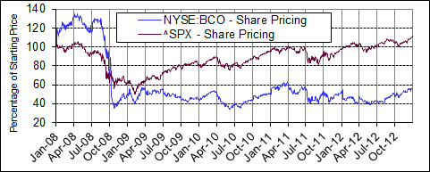
Stock Price v. S&P 500
Source: S&P Capital IQ

Slide 35
Executive Compensation
Key Executive Compensation | 2008 | 2009 | 2010 | 2011 | 2012
Salary | 512,596 | 1,036,154 | 1,236,916 | 1,818,242 | 2,551,788
Bonus | 380,000 | 515,000 | 720,000 | 928,000 | 1,646,437
Annual Other Income | 0 | 0 | 0 | 0 | 0
Restricted Stock Award | 300,007 | 1,636,662 | 637,687 | 743,048 | 3,802,880
Securities Options | 558,313 | 307,456 | 427,943 | 767,840 | 2,108,519
LTIP Payout | 0 | 0 | 0 | 0 | 0
Non-Equity Compensation | 361,920 | 196,680 | 126,080 | 55,020 | 273,636
Other Compensation | 178,684 | 422,952 | 377,405 | 506,975 | 883,900
Total | 2,291,520 | 4,114,904 | 3,526,031 | 4,819,125 | 11,267,160
Source: Morningstar

Slide 36
Global Beta Calculation
Source: Bloomberg, Team’s Analysis

Slide 37
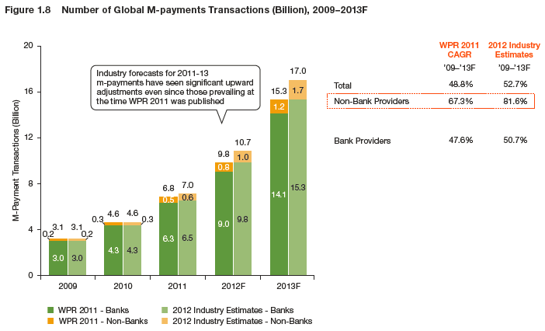
Global M-payments Transactions
Source: 2012 World Payments Report

Slide 38
MSCI v. Security & Alarm Services Index
Source: Bloomberg, Team’s Analysis

Slide 39
G4S Key Statistics
 | 2008 | 2009 | 2010 | 2011 | LTM 2012
Total Revenue | 9,360.5 | 11,066.6 | 11,459.7 | 11,876.5 | 12,219.2
Growth Over Prior Year | 32.2% | 18.2% | 3.6% | 3.6% | 5.8%
Gross Profit | 2,072.8 | 2,425.2 | 2,467.8 | 2,523.1 | 2,519.9
Margin % | 22.1% | 21.9% | 21.5% | 21.2% | 20.6%
EBITDA | 836.3 | 966.3 | 1,038.9 | 1,057.9 | 1,046.8
Margin % | 8.9% | 8.7% | 9.1% | 8.9% | 8.6%
EBIT | 548.7 | 626.8 | 680.5 | 702.6 | 685.2
Margin % | 5.9% | 5.7% | 5.9% | 5.9% | 5.6%
Earnings from Cont. Ops. | 303.8 | 356.8 | 410.5 | 352.1 | 236.8
Margin % | 3.2% | 3.2% | 3.6% | 3.0% | 1.9%
Net Income | 238.7 | 318.9 | 352.1 | 285.8 | 161.0
Margin % | 2.6% | 2.9% | 3.1% | 2.4% | 1.3%
Diluted EPS Excl. Extra Items³ | 0.2 | 0.2 | 0.3 | 0.2 | 0.2
Growth Over Prior Year | 14.4% | 13.1% | 13.7% | (13.4%) | (46.5%)
Currency | USD | USD | USD | USD | USD
Exchange Rate | 1.579 | 1.579 | 1.579 | 1.579 | 1.579
Source: S&P Capital IQ, Team’s Analysis

Slide 40
Garda Key Statistics
 | 2008 | 2009 | 2010 | 2011 | LTM 2012
Total Revenue | 1,011.7 | 1,102.1 | 1,080.4 | 1,117.8 | 1,221.9
Growth Over Prior Year | 48.5% | 8.9% | (2.0%) | 3.5% | 9.3%
Gross Profit | 228.7 | 276.3 | 279.4 | 229.5 | 244.3
Margin % | 22.6% | 25.1% | 25.9% | 20.5% | 20.0%
EBITDA | 92.8 | 114.7 | 124.9 | 125.2 | 126.3
Margin % | 9.2% | 10.4% | 11.6% | 11.2% | 10.3%
EBIT | 50.8 | 61.6 | 73.3 | 77.7 | 76.6
Margin % | 5.0% | 5.6% | 6.8% | 6.9% | 6.3%
Earnings from Cont. Ops. | 12.1 | (73.3) | (27.4) | 28.5 | 21.5
Margin % | 1.2% | (6.7%) | (2.5%) | 2.5% | 1.8%
Net Income | 15.6 | (97.9) | (35.2) | 28.5 | 21.5
Margin % | 1.5% | (8.9%) | (3.3%) | 2.5% | 1.8%
Diluted EPS Excl. Extra Items³ | 0.4 | (2.3) | (0.9) | 0.9 | 0.7
Growth Over Prior Year | (45.7%) | NM | NM | NM | (24.7%)
Currency | USD | USD | USD | USD | USD
Exchange Rate | 0.998 | 0.998 | 0.998 | 0.998 | 0.998
Source: S&P Capital IQ, Team’s Analysis

Slide 41
Loomis Key Statistics
 | 2008 | 2009 | 2010 | 2011 | LTM 2012
Total Revenue | 1,773.7 | 1,888.7 | 1,738.1 | 1,728.7 | 1,794.2
Growth Over Prior Year | (1.2%) | 6.5% | (8.0%) | (0.5%) | 5.6%
Gross Profit | 387.4 | 412.0 | 396.5 | 380.8 | 399.4
Margin % | 21.8% | 21.8% | 22.8% | 22.0% | 22.3%
EBITDA | 224.2 | 250.3 | 247.3 | 247.3 | 264.8
Margin % | 12.6% | 13.3% | 14.2% | 14.3% | 14.8%
EBIT | 115.5 | 129.2 | 136.4 | 140.2 | 149.2
Margin % | 6.5% | 6.8% | 7.8% | 8.1% | 8.3%
Earnings from Cont. Ops. | 66.8 | 78.8 | 78.1 | 80.8 | 95.8
Margin % | 3.8% | 4.2% | 4.5% | 4.7% | 5.3%
Net Income | 66.8 | 78.8 | 78.1 | 80.8 | 95.8
Margin % | 3.8% | 4.2% | 4.5% | 4.7% | 5.3%
Diluted EPS Excl. Extra Items³ | 0.9 | 1.1 | 1.0 | 1.1 | 1.3
Growth Over Prior Year | NM | 17.9% | (4.1%) | 3.3% | 30.5%
Currency | USD | USD | USD | USD | USD
Exchange Rate | 0.158 | 0.158 | 0.158 | 0.158 | 0.158
Source: S&P Capital IQ, Team’s Analysis

Slide 42
Prosegur Key Statistics
 | 2008 | 2009 | 2010 | 2011 | 2012
Total Revenue | 2,784.8 | 2,966.9 | 3,481.5 | 3,823.2 | 4,733.9
Growth Over Prior Year | 11.4% | 6.5% | 17.3% | 9.8% | 28.3%
Gross Profit | 844.9 | 753.1 | 883.6 | 940.9 | 994.6
Margin % | 30.3% | 25.4% | 25.4% | 24.6% | 21.0%
EBITDA | 351.5 | 402.9 | 470.6 | 494.5 | 548.2
Margin % | 12.6% | 13.6% | 13.5% | 12.9% | 11.6%
EBIT | 289.3 | 315.5 | 357.6 | 386.7 | 420.6
Margin % | 10.4% | 10.6% | 10.3% | 10.1% | 8.9%
Earnings from Cont. Ops. | 170.0 | 199.7 | 217.7 | 226.7 | 222.8
Margin % | 6.1% | 6.7% | 6.3% | 5.9% | 4.7%
Net Income | 172.4 | 200.6 | 218.2 | 227.3 | 223.7
Margin % | 6.2% | 6.8% | 6.3% | 5.9% | 4.7%
Diluted EPS Excl. Extra Items³ | 0.3 | 0.3 | 0.4 | 0.4 | 0.4
Growth Over Prior Year | 29.1% | 18.9% | 8.5% | 6.0% | 2.0%
Currency | USD | USD | USD | USD | USD
Exchange Rate | 1.357 | 1.357 | 1.357 | 1.357 | 1.357
Source: S&P Capital IQ, Team’s Analysis

Slide 43
Comparable Analysis, Pt. I
Company | Ticker | Closing Price | Shares Outstanding | Market Capitalization | Net Debt | Minority Interest | Enterprise Value | 5-year Beta
The Brink’s Company | NSYE: BCO | $30.09 | $47.80 | $1,438.30 | $222.50 | $74.90 | $1,609.10 | 1.3
G4S | LSE: GFS | 2.8 | 1404.4 | 3904.2 | 2891.7 | 0.0 | 8528.8 | 0.0
Garda World Security | TSX: GW | N/A | N/A | N/A | 632.2 | 0.0 | 1019.3 | -
Loomis Ab | STO:LOOM-B | 106.5 | 73.0 | 7774.5 | 372.0 | 0.0 | 1408.2 | 0.3
Prosegur Compania de Seguridad | CATS: PSG | 4.7 | 573.4 | 2683.5 | 748.2 | 0.0 | 3889.1 | 0.0
Werner Enterprises | NSDQ:WERN | 23.6 | 73.2 | 1723.9 | - | 0.0 | 1705.8 | 0.6
 | Average | 33.5 | 434.4 | 3504.9 | 973.3 | 12.5 | 3026.7 | 0.5
 | Median | 23.6 | 73.2 | 2683.5 | 632.2 | 0.0 | 1657.5 | 0.3
 | High | 106.5 | 1404.4 | 7774.5 | 2891.7 | 74.9 | 8528.8 | 1.3
 | Low | 2.8 | 47.8 | 1438.3 | 222.5 | 0.0 | 1019.3 | 0.0
Source: S&P Capital IQ, Team’s Analysis

Slide 44
Comparable Analysis, Pt. II
Company | Revenue | EBITDA | Net Income | EPS | Gross Margin | EBITDA Margin | Operating Margin | Net Profit Margin
The Brink’s Company | $3,918.46 | $308.76 | $77.42 | $1.60 | 18.6% | 7.9% | 3.9% | 2.0%
G4S | 12483.26 | 1069.44 | 164.53 | 0.12 | 0.21 | 8.6% | 5.6% | 1.3%
Garda World Security | 1320.12 | 142.92 | 24.85 | - | 0.21 | 10.8% | 6.6% | 1.9%
Loomis Ab | 1708.31 | 252.14 | 91.20 | 1.25 | 0.22 | 14.8% | 8.3% | 5.3%
Prosegur Compania de Seguridad | 4562.33 | 528.38 | 215.62 | 0.37 | 0.21 | 11.6% | 8.9% | 4.7%
Werner Enterprises | 2034.63 | 320.64 | 106.42 | 1.46 | 0.24 | 15.8% | 7.7% | 5.2%
Average | $4,337.85 | $437.05 | $113.34 | $0.96 | 21.2% | 11.6% | 6.8% | 3.4%
Median | $2,976.54 | $314.70 | $98.81 | $1.25 | 20.8% | 11.2% | 7.2% | 3.4%
High | $12,483.26 | $1,069.44 | $215.62 | $1.60 | 23.9% | 15.8% | 8.9% | 5.3%
Low | $1,320.12 | $142.92 | $24.85 | $0.12 | 18.6% | 7.9% | 3.9% | 1.3%
Source: S&P Capital IQ, Team’s Analysis

Slide 45
Comparable Analysis, Pt. III
Company | ROE | ROA | P/E | P/B | P/CF | EV/ Total Revenue | EV/ EBITDA
The Brink’s Company | 17.64% | 3.04% | 18.75x | 3.26x | 3.65x | 0.43x | 5.41x
G4S | 7.22% | 1.84% | 22.17x | 1.64x | 0.01x | 0.53x | 6.19x
Garda World Security |  | 2.70% |  |  |  | 0.46x | 4.27x
Loomis Ab | 18.04% | 6.77% | 82.40x | 14.87x | 1.51x | 4.62x | 31.29x
Prosegur Compania de Seguridad | 22.97% | 5.80% | 12.59x | 2.85x | 0.03x | 0.75x | 6.48x
Werner Enterprises | 13.37% | 7.90% | 16.12x | 2.17x | -0.41x | 0.84x | 5.32x
Average | 15.85% | 4.68% | 30.41x | 4.96x | 0.96x | 1.3x | 9.8x
Median | 17.64% | 4.42% | 18.75x | 2.85x | 0.03x | 0.6x | 5.8x
High | 22.97% | 7.90% | 82.40x | 14.87x | 3.65x | 4.6x | 31.3x
Low | 7.22% | 1.84% | 12.59x | 1.64x | -0.41x | 0.4x | 4.3x
Source: S&P Capital IQ, Team’s Analysis

Slide 46
DuPont Analysis, Pt. I
 | The Brink's Company
 | 2007 | 2008 | 2009 | 2010 | 2011 | 2012E
Tax Burden | 85.44% | 81.61% | 120.38% | 40.90% | 47.63% | 56.59%
Interest Burden | 97.33% | 97.15% | 91.32% | 83.14% | 90.46% | 89.17%
Operating Margin | 6.04% | 7.31% | 5.81% | 5.38% | 4.45% | 3.92%
Asset Turnover | 1.14 | 1.74 | 1.67 | 1.37 | 1.61 | 1.54
Leverage | 2.15 | 5.95 | 3.16 | 3.89 | 4.99 | 5.80
CLF | 2.09 | 5.78 | 2.88 | 3.24 | 4.51 | 5.17
ROE | 12.32% | 60.04% | 33.60% | 9.79% | 15.44% | 17.64%
Source: Team’s Analysis

Slide 47
DuPont Analysis, Pt. II
 | G4S
 | 2007 | 2008 | 2009 | 2010 | 2011 | LTM 2012
Tax Burden | 68.12% | 57.56% | 66.67% | 66.57% | 64.87% | 53.97%
Interest Burden | 79.51% | 75.60% | 76.32% | 77.73% | 62.70% | 43.55%
Operating Margin | 6.06% | 5.86% | 5.66% | 5.94% | 5.92% | 5.61%
Asset Turnover | 1.22 | 1.06 | 1.36 | 1.35 | 1.34 | 1.39
Leverage | 3.29 | 3.82 | 3.59 | 3.31 | 3.64 | 3.93
CLF | 2.62 | 2.89 | 2.74 | 2.58 | 2.28 | 1.71
ROE | 13.14% | 10.28% | 14.03% | 13.74% | 11.72% | 7.22%
 | Garda
 | 2007 | 2008 | 2009 | 2010 | 2011 | LTM 2012
Tax Burden | 836.62% | 108.37% | 69.38% | 146.98% | 169.00% | 131.46%
Interest Burden | 3.66% | -146.78% | -69.16% | 24.95% | 16.64% | 21.64%
Operating Margin | 5.02% | 5.59% | 6.78% | 6.95% | 6.27% | 6.62%
Asset Turnover | 1.06 | 1.12 | 1.35 | 1.43 | 1.39 | 1.43
Leverage | 7.93 | 16.19 | 18.12 | 11.56 | 9.43 | 8.69
CLF | 0.29 | -23.77 | -12.53 | 2.88 | 1.57 | 1.88
ROE | 12.95% | -161.21% | -79.44% | 42.23% | 23.16% | 23.46%
Source: Team’s Analysis

Slide 48
DuPont Analysis, Pt. III
 | Loomis
 | 2007 | 2008 | 2009 | 2010 | 2011 | LTM 2012
Tax Burden | -155.96% | 74.52% | 70.82% | 65.44% | 69.04% | 70.86%
Interest Burden | -234.31% | 77.63% | 86.10% | 87.53% | 83.48% | 90.60%
Operating Margin | 2.11% | 6.51% | 6.84% | 7.85% | 8.11% | 8.32%
Asset Turnover | 1.36 | 1.26 | 1.47 | 1.46 | 1.21 | 1.27
Leverage | 5.55 | 2.99 | 2.61 | 2.43 | 2.67 | 2.66
CLF | -13.02 | 2.32 | 2.24 | 2.13 | 2.23 | 2.41
ROE | 58.52% | 14.25% | 15.98% | 15.88% | 15.10% | 18.04%
 | Prosegur
 | 2007 | 2008 | 2009 | 2010 | 2011 | LTM 2012
Tax Burden | 66.24% | 69.50% | 70.14% | 69.54% | 66.35% | 65.09%
Interest Burden | 89.27% | 85.77% | 90.65% | 87.77% | 88.57% | 81.72%
Operating Margin | 9.03% | 10.39% | 10.64% | 10.27% | 10.11% | 8.89%
Asset Turnover | 1.36 | 1.42 | 1.36 | 1.30 | 1.29 | 1.23
Leverage | 3.55 | 3.40 | 3.05 | 2.96 | 3.27 | 3.96
CLF | 3.17 | 2.91 | 2.77 | 2.60 | 2.89 | 3.24
ROE | 25.71% | 29.92% | 28.14% | 24.12% | 24.96% | 22.97%
Source: Team’s Analysis

Slide 49
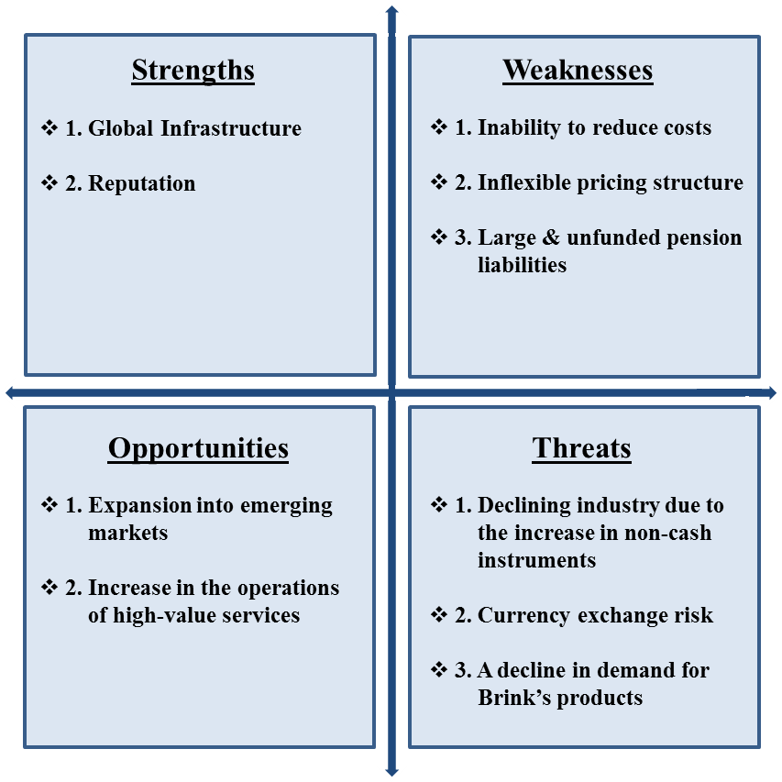
S.W.O.T. Analysis
Source: Team’s Analysis

Slide 50
Porter’s Five Forces Model
Source: Team’s Analysis
Notes:
After an in depth analysis into Michael Porter’s Five forces we determined that Brink’s future is at the mercy of others, and there are a lot of negative aspects. The possibility of new entrants is moderate due to low barriers of entry, which are created because customers are willing to go with lesser known brands based on lower prices. The threat of substitute products we found to be very high given how imitable the services and products Brink’s offers are. As far as the bargaining power of suppliers and customers, we find that Brink’s customers do have power based on the number of substitutes. The suppliers of the company have been determined to have a moderate level of bargaining power based on the inelastic demand for the inputs in Brink’s production. Finally, the competitive rivalry within the industry was found to be very high, which is partially due to Brink’s losing market share based on the fact that they aren’t priced competitively.

Slide 51
Brink’s Income Statement
Income Statement (Millions) | 2007 | 2008 | 2009 | 2010 | 2011 | 2012A/E | 2013E | 2014E | 2015E | 2016E | 2017E
Revenue | 2735 | 3164 | 3135 | 3122 | 3886 | 3918 | 4232 | 4528 | 4800 | 5040 | 5241
COGS | 2195 | 2505 | 2535 | 2536 | 3174 | 3189 | 3439 | 3680 | 3901 | 4096 | 4260
Gross Profit | 540 | 658 | 601 | 585 | 711 | 730 | 793 | 848 | 899 | 944 | 982
SG&A | 380 | 434 | 430 | 429 | 543 | 570 | 609 | 648 | 682 | 711 | 734
EBITDA | 261 | 339 | 304 | 292 | 319 | 309 | 358 | 387 | 414 | 440 | 463
D&A | 96 | 108 | 122 | 124 | 147 | 153 | 169 | 181 | 192 | 202 | 210
EBIT | 165 | 231 | 182 | 168 | 173 | 153 | 188 | 206 | 222 | 238 | 253
Interest Expense | -4 | -7 | -16 | -28 | -17 | -10 | -19 | -18 | -17 | -15 | -13
EBT | 161 | 225 | 166 | 140 | 156 | 137 | 169 | 187 | 206 | 223 | 240
Tax expense | 60 | 53 | -61 | 67 | 59 | 33 | 59 | 66 | 72 | 78 | 84
Net Income | 137 | 183 | 200 | 57 | 75 | 77 | 88 | 100 | 112 | 123 | 134
Source: Team’s Analysis

Slide 52
Brink’s Income Statement (Common Size)
Income Statement (Common Size) | 2007 | 2008 | 2009 | 2010 | 2011 | 2012A/E | 2013E | 2014E | 2015E | 2016E | 2017E
Revenue | 100.0% | 100.0% | 100.0% | 100.0% | 100.0% | 100.0% | 100.0% | 100.0% | 100.0% | 100.0% | 100.0%
COGS | 80.3% | 79.2% | 80.8% | 81.3% | 81.7% | 81.4% | 81.3% | 81.3% | 81.3% | 81.3% | 81.3%
Gross Profit | 19.7% | 20.8% | 19.2% | 18.7% | 18.3% | 18.6% | 18.7% | 18.7% | 18.7% | 18.7% | 18.7%
SG&A | 13.9% | 13.7% | 13.7% | 13.8% | 14.0% | 14.6% | 14.4% | 14.3% | 14.2% | 14.1% | 14.0%
EBITDA | 9.5% | 10.7% | 9.7% | 9.3% | 8.2% | 7.9% | 8.4% | 8.5% | 8.6% | 8.7% | 8.8%
D&A | 3.5% | 3.4% | 3.9% | 4.0% | 3.8% | 3.9% | 4.0% | 4.0% | 4.0% | 4.0% | 4.0%
EBIT | 6.0% | 7.3% | 5.8% | 5.4% | 4.4% | 3.9% | 4.4% | 4.5% | 4.6% | 4.7% | 4.8%
Interest Expense | -0.2% | -0.2% | -0.5% | -0.9% | -0.4% | -0.2% | -0.5% | -0.4% | -0.4% | -0.3% | -0.3%
EBT | 5.9% | 7.1% | 5.3% | 4.5% | 4.0% | 3.5% | 4.0% | 4.1% | 4.3% | 4.4% | 4.6%
Tax expense | 2.2% | 1.7% | -1.9% | 2.1% | 1.5% | 0.8% | 1.4% | 1.4% | 1.5% | 1.6% | 1.6%
Net Income | 5.0% | 5.8% | 6.4% | 1.8% | 1.9% | 2.0% | 2.1% | 2.2% | 2.3% | 2.4% | 2.6%
Source: Team’s Analysis

Slide 53
Transaction Summary
Announced Date | Closed Date | Transaction Type | Role | Target | Buyer/Investors | Sellers | Size ($mm)
Nov-15-2012 | - | Merger/Acquisition | Seller | The Brink's Company, Event Security Operations in France | Groupe Ageparfi | The Brink's Company (NYSE:BCO) | -
Nov-09-2012 | - | Merger/Acquisition | Seller - Parent | Brink’s C.L. Polska Sp.zo.o | Impel Security Polska Sp. z o.o. | Brink’s Dutch Holdings, B.V. | -
Aug-13-2012 | Aug-13-2012 | Merger/Acquisition | Buyer - Parent | STG Werte- und Transportlogistik GmbH | Brink's Deutschland GmbH |  | -
Jan-09-2012 | Jan-09-2012 | Merger/Acquisition | Buyer | Kheops, SAS | The Brink's Company (NYSE:BCO) |  | 17.0
Jul-25-2011 | Jul-22-2011 | Merger/Acquisition | Seller - Parent | Brink's Document Destruction, LLC | Shred-It International, Inc. | Brink's, Incorporated | -
Feb-17-2011 | Feb-17-2011 | Merger/Acquisition | Seller - Parent | Brink's Belgium S.A., Site In Ghent | Cobelguard NV/SA | Brink's Belgium S.A. | -
Feb-17-2011 | Feb-17-2011 | Merger/Acquisition | Seller - Parent | Brink's Belgium S.A., Counting Machine | bpost international | Brink's Belgium S.A. | -
Feb-17-2011 | Feb-17-2011 | Merger/Acquisition | Seller - Parent | Brink's Belgium S.A., Large Quantity of Trucks | G4S plc (LSE:GFS) | Brink's Belgium S.A. | -
Feb-09-2011 | Feb-09-2011 | Merger/Acquisition | Seller - Parent | Brink's Belgium S.A., Client Portfolio | G4S plc (LSE:GFS) | Brink's Belgium S.A. | -
Jan-24-2011 | Jan-24-2011 | Private Placement | Target | The Brink's Company (NYSE:BCO) |  |  | 100.0
Source: S&P Capital IQ, Team’s Analysis

Slide 54
Transaction Summary, Pt. II
Dec-23-2010 | Dec-23-2010 | Merger/Acquisition | Buyer - Parent | Threshold Financial Technologies Inc. | Brink's Canada Limited | Versent Corporation ULC | 38.8
Nov-17-2010 | Nov-17-2010 | Merger/Acquisition | Buyer - Parent | Servicio Pan Americano De Proteccion, S.A. De C.V. | Brink's, Incorporated | Banco Santander, S.A. (CATS:SAN) | 60.0
Feb-05-2010 | Feb-05-2010 | Merger/Acquisition | Buyer - Parent | Est Valeurs SA | Brink's France S.A.S. | Temis S.A. | -
Sep-04-2009 | Sep-04-2009 | Merger/Acquisition | Target - Parent | ICD Security Solutions | The Brink's Company (NYSE:BCO) |  | -
Sep-01-2009 | Sep-01-2009 | Merger/Acquisition | Target - Parent | Brink’s Arya India Pvt. Ltd. | The Brink's Company (NYSE:BCO) |  | 22.2
Jan-08-2009 | Jan-08-2009 | Merger/Acquisition | Buyer - Parent | Sebival-Seguranca Bancaria Industrial e de Valores Ltda. | Brink's Seguranca e Transporte de Valores Ltda. |  | 50.0
Nov-14-2008 | Nov-14-2008 | Merger/Acquisition | Seller | Brink’s Co., Certain Coal Assets | Massey Energy Co. (nka:Alpha Appalachia Holdings, Inc.) | The Brink's Company (NYSE:BCO) | 16.0
Apr-11-2008 | Apr-11-2008 | Merger/Acquisition | Buyer - Parent | Madison Armored Car LLC | Brink's, Incorporated |  | -
Feb-25-2008 | Oct-31-2008 | Spin-Off/Split-Off | Seller | Brink’s Home Security Holdings, Inc. (nka:Broadview Security, Inc.) |  | The Brink's Company (NYSE:BCO) | 972.59
Sep-14-2007 | Aug-31-2010 | Buyback | Target | The Brink's Company (NYSE:BCO) |  |  | 100.0
Aug-06-2007 | Aug-06-2007 | Merger/Acquisition | Seller | Brink’s Co., Cash Handling Operations in UK | Loomis UK Ltd. | The Brink's Company (NYSE:BCO) | 2.23
Source: S&P Capital IQ, Team’s Analysis

Slide 55
Brink’s Balance Sheet
Balance Sheet | 2007 | 2008 | 2009 | 2010 | 2011 | 2012A/E | 2013E | 2014E | 2015E | 2016E | 2017E
Assets
Cash and Cash Equivalents | 196 | 251 | 143 | 183 | 183 | 170 | 212 | 226 | 240 | 252 | 262
Receivables | 492 | 451 | 428 | 525 | 551 | 593 | 651 | 697 | 738 | 775 | 806
Other Current Assets | 64 | 31 | 39 | 48 | 67 | 93 | 58 | 62 | 66 | 69 | 72
Total Current Assets | 846 | 832 | 690 | 877 | 934 | 992 | 1060 | 1134 | 1202 | 1262 | 1313
Long-Term Investments | 67 | 57 | 56 | 41 | 22 | 0 | 42 | 45 | 48 | 50 | 52
Net PPE | 1118 | 534 | 550 | 699 | 749 | 773 | 846 | 906 | 960 | 1008 | 1048
Other Non-Current Assets | 196 | 232 | 301 | 326 | 406 | 491 | 423 | 453 | 480 | 504 | 524
Total Assets | 2394 | 1816 | 1880 | 2271 | 2406 | 2545 | 2681 | 2852 | 3009 | 3147 | 3263
Liabilities and Equity
Short-Term Liabilities | 23 | 16 | 23 | 66 | 54 | 35 | 78 | 74 | 70 | 65 | 59
Payables | 172 | 138 | 127 | 142 | 160 | 167 | 188 | 202 | 214 | 224 | 233
Accrued Expenses | 390 | 361 | 364 | 413 | 449 | 472 | 508 | 543 | 576 | 605 | 629
Other Current Liabilities | 55 | 21 | 6 | 56 | 40 | 1 | 53 | 57 | 60 | 63 | 66
Total Current Liabilities | 640 | 535 | 520 | 676 | 702 | 727 | 827 | 876 | 920 | 957 | 987
Long-Term Liabilities | 75 | 173 | 172 | 324 | 262 | 293 | 311 | 307 | 299 | 285 | 268
Pension Liabilities | 162 | 623 | 390 | 485 | 685 | 618 | 556 | 482 | 407 | 332 | 281
Other Non-Current Liabilities | 180 | 158 | 171 | 172 | 178 | 183 | 188 | 189 | 226 | 248 | 252
Total Liabilities | 1280 | 1511 | 1284 | 1687 | 1924 | 2131 | 1913 | 1885 | 1883 | 1853 | 1818
Stockholder's Equity | 48 | 46 | 48 | 46 | 47 | 48 | 48 | 48 | 48 | 48 | 48
Retained Earnings | 676 | 310 | 515 | 538 | 590 | 646 | 712 | 787 | 871 | 964 | 1064
Total Equity | 1115 | 305 | 596 | 583 | 482 | 439 | 768 | 968 | 1126 | 1294 | 1445
Liabilities and Shareholder's Equity | 2394 | 1816 | 1880 | 2271 | 2406 | 2545 | 2681 | 2852 | 3009 | 3147 | 3263
Source: S&P Capital IQ, Team’s Analysis

Slide 56
Brink’s Balance Sheet (Common Size)
Balance Sheet (Common Size) | 2007 | 2008 | 2009 | 2010 | 2011 | 2012A/E | 2013E | 2014E | 2015E | 2016E | 2017E
Assets
Cash and Cash Equivalents | 8.2% | 13.8% | 7.6% | 8.1% | 7.6% | 6.7% | 7.9% | 7.9% | 8.0% | 8.0% | 8.0%
Receivables | 20.5% | 24.8% | 22.7% | 23.1% | 22.9% | 23.3% | 24.3% | 24.4% | 24.5% | 24.6% | 24.7%
Other Current Assets | 2.7% | 1.7% | 2.0% | 2.1% | 2.8% | 3.6% | 2.2% | 2.2% | 2.2% | 2.2% | 2.2%
Total Current Assets | 35.3% | 45.8% | 36.7% | 38.6% | 38.8% | 39.0% | 39.5% | 39.8% | 39.9% | 40.1% | 40.2%
Long-Term Investments | 2.8% | 3.1% | 3.0% | 1.8% | 0.9% | 0.0% | 1.6% | 1.6% | 1.6% | 1.6% | 1.6%
Net PPE | 46.7% | 29.4% | 29.2% | 30.8% | 31.1% | 30.4% | 31.6% | 31.8% | 31.9% | 32.0% | 32.1%
Other Non-Current Assets | 8.2% | 12.8% | 16.0% | 14.3% | 16.9% | 19.3% | 15.8% | 15.9% | 16.0% | 16.0% | 16.1%
Total Assets | 100.0% | 100.0% | 100.0% | 100.0% | 100.0% | 100.0% | 100.0% | 100.0% | 100.0% | 100.0% | 100.0%
Liabilities and Equity
Short-Term Liabilities | 1.0% | 0.9% | 1.2% | 2.9% | 2.2% | 1.4% | 2.9% | 2.6% | 2.3% | 2.1% | 1.8%
Payables | 7.2% | 7.6% | 6.8% | 6.2% | 6.6% | 6.6% | 7.0% | 7.1% | 7.1% | 7.1% | 7.2%
Accrued Expenses | 16.3% | 19.9% | 19.4% | 18.2% | 18.6% | 18.5% | 18.9% | 19.1% | 19.1% | 19.2% | 19.3%
Other Current Liabilities | 2.3% | 1.2% | 0.3% | 2.5% | 1.7% | 0.0% | 2.0% | 2.0% | 2.0% | 2.0% | 2.0%
Total Current Liabilities | 26.7% | 29.5% | 27.7% | 29.8% | 29.2% | 28.6% | 30.8% | 30.7% | 30.6% | 30.4% | 30.2%
Long-Term Liabilities | 3.1% | 9.5% | 9.2% | 14.3% | 10.9% | 11.5% | 11.6% | 10.8% | 9.9% | 9.1% | 8.2%
Pension Liabilities | 6.8% | 34.3% | 20.8% | 21.4% | 28.5% | 24.3% | 20.7% | 16.9% | 13.5% | 10.6% | 8.6%
Other Non-Current Liabilities | 7.5% | 8.7% | 9.1% | 7.6% | 7.4% | 7.2% | 7.0% | 6.6% | 7.5% | 7.9% | 7.7%
Total Liabilities | 53.5% | 83.2% | 68.3% | 74.3% | 80.0% | 83.7% | 71.3% | 66.1% | 62.6% | 58.9% | 55.7%
Stockholder's Equity | 2.0% | 2.5% | 2.5% | 2.0% | 1.9% | 1.9% | 1.8% | 1.7% | 1.6% | 1.5% | 1.5%
Retained Earnings | 28.2% | 17.1% | 27.4% | 23.7% | 24.5% | 25.4% | 26.6% | 27.6% | 29.0% | 30.6% | 32.6%
Total Equity | 46.5% | 16.8% | 31.7% | 25.7% | 20.0% | 17.2% | 28.7% | 33.9% | 37.4% | 41.1% | 44.3%
Total Liabilities and Shareholder's Equity | 100.0% | 100.0% | 100.0% | 100.0% | 100.0% | 100.0% | 100.0% | 100.0% | 100.0% | 100.0% | 100.0%
Source: S&P Capital IQ, Team’s Analysis

Slide 57
Brink’s Statement of Cash Flows
 | 2007 | 2008 | 2009 | 2010 | 2011 | 2012A/E | 2013E | 2014E | 2015E | 2016E | 2017E
Cash From Operating Activities
Net Income | 137 | 183 | 200 | 57 | 75 | 77 | 88 | 100 | 112 | 123 | 134
Depreciation and Amortization | 96 | 108 | 122 | 124 | 147 | 153 | 180 | 192 | 203 | 212 | 221
Change in Net Working Capital | 62 | 91 | -128 | 32 | 30 | 34 | -33 | 25 | 49 | 47 | 44
Other Cash from Operating Activities | 159 | 44 | 1 | 23 | -4 | -58 | -88 | -118 | -126 | -132 | -137
Total Cash From Operating Activities | 454 | 427 | 195 | 235 | 247 | 206 | 148 | 199 | 238 | 251 | 261
Cash From Investing Activities
Net Capital Expenditure | -142 | -165 | -171 | -149 | -196 | -198 | -212 | -226 | -240 | -252 | -262
Sale of Property, Plant, and Equipment | 14 | 17 | 11 | 5 | 14 | 14 | 12 | 12 | 12 | 12 | 12
Cash Acquisitions | -13 | -12 | -75 | -101 | -3 | -17 | 0 | 0 | 0 | 0 | 0
Other Cash From Investing Activities | -176 | -199 | 0 | -9 | 1 | 12 | 0 | 0 | 0 | 0 | 0
Total Cash From Investing | -318 | -360 | -241 | -255 | -172 | -175 | -196 | -211 | -225 | -237 | -247
Cash From Financing Activities
Debt Issued | 7 | 94 | 14 | 153 | 118 | 45 | 163 | 102 | 79 | 80 | 80
Debt Repaid | -69 | -17 | -23 | -20 | -154 | -38 | -33 | -33 | -33 | -33 | -33
Dividends Paid | -17 | -18 | -18 | -19 | -19 | -19 | -22 | -25 | -28 | -31 | -34
Other Cash From Financing Activities | -7 | -58 | -20 | -55 | -12 | -19 | -18 | -18 | -18 | -18 | -18
Total Cash From Financing | -85 | 0 | -47 | 60 | -67 | -31 | 90 | 26 | 0 | -2 | -4
Beginning Cash | 137 | 196 | 251 | 143 | 183 | 183 | 170 | 212 | 226 | 240 | 252
Ending Cash | 196 | 251 | 143 | 183 | 183 | 170 | 212 | 226 | 240 | 252 | 262
Source: S&P Capital IQ, Team’s Analysis

Slide 58
Financial Analysis Ratios
 | 2007 | 2008 | 2009 | 2010 | 2011 | 2012A/E | 2013E | 2014E | 2015E | 2016E | 2017E
Liquidity Ratios
Current Ratio (x) | 1.3x | 1.6x | 1.3x | 1.3x | 1.3x | 1.4x | 1.3x | 1.3x | 1.3x | 1.3x | 1.3x
Quick Ratio (x) | 1.1x | 1.3x | 1.1x | 1.0x | 1.0x | 1.1x | 1.0x | 1.1x | 1.1x | 1.1x | 1.1x
Cash Ratio (x) | 0.3x | 0.5x | 0.3x | 0.3x | 0.3x | 0.2x | 0.3x | 0.3x | 0.3x | 0.3x | 0.3x
Efficiency Ratios
Total Asset Turnover (x) | 1.1x | 1.7x | 1.7x | 1.4x | 1.6x | 1.5x | 1.6x | 1.6x | 1.6x | 1.6x | 1.6x
Fixed Asset Turnover (x) | 2.4x | 5.9x | 5.7x | 4.5x | 5.2x | 5.1x | 5.0x | 5.0x | 5.0x | 5.0x | 5.0x
Accounts Receivable Turnover (x) | 5.9x | 7.5x | 8.2x | 6.4x | 7.8x | 7.1x | 10.6x | 10.5x | 10.4x | 10.4x | 10.4x
Payables Turnover (x) | 15.9x | 23.0x | 24.6x | 22.1x | 24.4x | 23.5x | 22.5x | 22.5x | 22.5x | 22.5x | 22.5x
Profitability Ratios
Gross Profit Margin (%) | 19.7% | 20.8% | 19.2% | 18.7% | 18.3% | 18.6% | 18.7% | 18.7% | 18.7% | 18.7% | 18.7%
EBIT Margin (%) | 6.0% | 7.3% | 5.8% | 5.4% | 4.4% | 3.9% | 4.4% | 4.5% | 4.6% | 4.7% | 4.8%
EBITDA Margin (%) | 9.5% | 10.7% | 9.7% | 9.3% | 8.2% | 7.9% | 8.4% | 8.5% | 8.6% | 8.7% | 8.8%
Net Profit Margin (%) | 5.0% | 5.8% | 6.4% | 1.8% | 1.9% | 2.0% | 2.1% | 2.2% | 2.3% | 2.4% | 2.6%
ROA (%) | 5.7% | 10.1% | 10.7% | 2.5% | 3.1% | 3.0% | 3.3% | 3.5% | 3.7% | 3.9% | 4.1%
ROE (%) | 12.3% | 60.0% | 33.6% | 9.8% | 15.4% | 17.6% | 11.5% | 10.3% | 9.9% | 9.5% | 9.3%
Solvency Ratios
Debt to Equity Ratio (x) | 1.1x | 4.9x | 2.2x | 2.9x | 4.0x | 4.9x | 2.5x | 1.9x | 1.7x | 1.4x | 1.3x
Long Term Debt Ratio (%) | 60.9% | 79.1% | 78.2% | 87.5% | 84.8% | 86.0% | 86.6% | 86.5% | 86.1% | 85.6% | 84.8%
Source: S&P Capital IQ, Team’s Analysis

Slide 59
Institutional Holdings
Holder | Common Stock Equivalent Held | % Of Common Stock Outstanding | Market Value (USD in mm) | % Change | Calculated Investment Style | Market Cap Emphasis
SouthernSun Asset Management, LLC | 3,642,966.00 | 7.626 | 111.1 | (2.27) | GARP | Mid cap
BlackRock, Inc. (NYSE:BLK) | 3,458,592.00 | 7.24 | 105.5 | (4.18) | GARP | Large cap
GAMCO Investors, Inc. (NYSE:GBL) | 3,051,210.00 | 6.387 | 93.1 | 10.04 | Growth | Large cap
Allianz Global Investors AG | 2,875,287.00 | 6.019 | 87.7 | (0.93) | GARP | Large cap
The Vanguard Group, Inc. | 2,477,762.00 | 5.187 | 75.6 | 1.25 | GARP | Large cap
Cantillon Capital Management LLC | 2,150,533.00 | 4.502 | 65.6 | New | Aggressive Growth | Large cap
State Street Global Advisors, Inc. | 1,747,347.00 | 3.658 | 53.3 | 13.19 | GARP | Large cap
Royce & Associates, LLC | 1,712,485.00 | 3.585 | 52.2 | 2.87 | Growth | Multi cap
Robeco Group N.V. | 1,340,691.00 | 2.807 | 40.9 | (13.46) | GARP | Large cap
Dreman Value Management, L.L.C. | 1,310,765.00 | 2.744 | 40.0 | (2.71) | GARP | Mid cap
BNY Mellon Asset Management | 1,224,939.00 | 2.564 | 37.4 | (9.41) | GARP | Large cap
Denver Investments | 1,159,416.00 | 2.427 | 35.4 | 21.47 | GARP | Multi cap
Northern Trust Global Investments | 1,060,272 | 2.22 | 32.3 | 5.58 | GARP | Large cap
Source: S&P Capital IQ, Team’s Analysis

Slide 60
Institutional Holdings, Pt. II
Deutsche Asset Management Group | 934,793 | 1.957 | 28.5 | (4.04) | GARP | Large cap
Cambiar Investors, LLC | 930,277 | 1.947 | 28.4 | 0.43 | GARP | Large cap
River Road Asset Management, LLC | 857,720 | 1.796 | 26.2 | (18.56) | GARP | Large cap
Columbia Management Investment Advisers, LLC | 845,952 | 1.771 | 25.8 | 5.1 | GARP | Large cap
Ceredex Value Advisors LLC | 834,520 | 1.747 | 25.5 | 26.68 | GARP | Large cap
Neuberger Berman LLC | 813,861 | 1.704 | 24.8 | 4.44 | Growth | Large cap
Channing Capital Management, LLC | 808,617 | 1.693 | 24.7 | (6.72) | GARP | Mid cap
Ariel Investments, LLC | 796,551 | 1.668 | 24.3 | 29.17 | GARP | Mid cap
Managed Account Advisors LLC | 775,463 | 1.623 | 23.7 | 3.33 | GARP | Large cap
Diamond Hill Capital Management, Inc. | 665,757 | 1.394 | 20.3 | (0.93) | GARP | Large cap
Delaware Management Business Trust | 611,634 | 1.28 | 18.7 | 3.79 | Growth | Large cap
Pinnacle Associates Ltd | 596,382 | 1.248 | 18.2 | (0.04) | Growth | Large cap
Dimensional Fund Advisors LP | 583,360 | 1.221 | 17.8 | 3.24 | GARP | Multi cap
Source: S&P Capital IQ, Team’s Analysis

Slide 61
Capital Structure & Weighted Average Cost of Capital
 | (Millions) | % Weight
Market Capitalization | $1,228.00 | 74.29%
Short Term Debt | 62 | 3.75%
Long Term Debt | 363 | 21.96%
Preferred Equity | 0 | 0.00%
Total Capital | $1,653.00 | 100.00%
 | Weight | Cost | Weighted Cost
Equity | 74.30% | 14.18% | 10.54%
Debt | 25.70% | 1.79% | 0.46%
Preferred | 0% | 0% | 0%
 |  | WACC | 11.00%
Source: Bloomberg, Team’s Analysis

Slide 62
Pension Liabilities, Pt. I
For the Fiscal Period Ending | 12 months Dec-31-2007 | 12 months Dec-31-2008 | 12 months Dec-31-2009 | 12 months Dec-31-2010 | 12 months Dec-31-2011 | Press Release 12 months Dec-31-2012
Pension Information - Total
Defined Benefit Net Periodic Cost
Def. Benefit Service Cost | 9.2 | 9.7 | 6.1 | 6.6 | 10.2 | -
Def. Benefit Plan Interest Cost | 54.5 | 58.7 | 59.9 | 59.9 | 63.1 | -
Def. Benefit Plan Return on Assets | (63.5) | (70.5) | (70.2) | (77.4) | (77.0) | -
Def. Benefit Plan Other Cost | 16.4 | 5.3 | 12.9 | 22.8 | 34.7 | -
Def. Benefit Plan Total Cost | 16.6 | 3.2 | 8.7 | 11.9 | 31.0 | -
Def. Contribution Plan Cost | 14.9 | 15.6 | 18.9 | 22.6 | 20.8 | -
Total Pension Expense | 31.5 | 18.8 | 27.6 | 34.5 | 51.8 | -
Defined Benefit Obligation
Beg. Def. Benefit Obligation | 971.9 | 963.6 | 965.6 | 1,033.9 | 1,179.7 | -
Def. Benefit Service Cost | 9.2 | 9.7 | 6.1 | 6.6 | 10.2 | -
Def. Benefit Interest Cost | 54.5 | 58.7 | 59.9 | 59.9 | 63.1 | -
Def. Benefit Employee Contributions | 3.2 | 2.9 | 2.8 | 2.9 | 3.5 | -
Def. Benefit Actuarial Gain/Losses | (66.1) | 1.1 | 32.5 | 86.8 | 110.0 | -
Def. Benefits Paid | (38.1) | (43.0) | (45.0) | (46.8) | (55.6) | -
Foreign Exchange Adj. | 26.9 | (26.8) | 15.5 | (2.1) | (10.5) | -
Acq. Benefit Obligation | 0.8 | - | - | 39.0 | - | -
Def. Benefit Settlement/Curtailment | (0.9) | (0.6) | (3.5) | (0.5) | (2.8) | -
Other Adj. To Def. Benefit Obligation | 2.2 | - | - | - | - | -
Proj. Benefit Obligation (Pension) | 963.6 | 965.6 | 1,033.9 | 1,179.7 | 1,297.6 | -
Accum. Benefit Obligation | - | - | - | 1,149.9 | 1,269.5 | -
Source: S&P Capital IQ, Team’s Analysis

Slide 63
Pension Liabilities, Pt. II
For the Fiscal Period Ending | 12 months Dec-31-2007 | 12 months Dec-31-2008 | 12 months Dec-31-2009 | 12 months Dec-31-2010 | 12 months Dec-31-2011 | Press Release 12 months Dec-31-2012
Plan Assets
Beg. Plan Assets | 835.2 | 904.7 | 588.0 | 847.1 | 917.0 | -
Actual Return on Plan Assets | 57.7 | (268.9) | 122.7 | 99.6 | 33.9 | -
Employer Contributions | 23.8 | 15.7 | 169.0 | 16.1 | 26.4 | -
Participant Contributions | 3.2 | 2.9 | 2.8 | 2.9 | 3.5 | -
Benefits Paid | (38.1) | (43.0) | (45.0) | (46.8) | (55.6) | -
Foreign Exchange Adjustments | 22.0 | (22.8) | 13.1 | (2.0) | (6.5) | -
Acquired Plan Assets | - | - | - | 0.6 | - | -
Plan Settlement/Curtailment | (0.9) | (0.6) | (3.5) | (0.5) | (2.8) | -
Other Plan Adjustments | 1.8 | - | - | - | - | -
Total Plan Assets | 904.7 | 588.0 | 847.1 | 917.0 | 915.9 | -
Weighted Avg. Assumptions on Net Periodic Cost
Rate of Comp. Increase - Min | 3.0% | 3.0% | 4.0% | 3.1% | 3.3% | -
Rate of Comp. Increase - Max | 3.0% | 3.0% | 4.0% | 3.1% | 3.3% | -
Weighted Avg. Assumptions on Def. Benefit Obligation
Rate of PBO Compensation Increase - Min | 3.0% | 4.0% | 3.1% | 3.3% | 3.2% | -
Rate of PBO Compensation Increase - Max | 3.0% | 4.0% | 3.1% | 3.3% | 3.2% | -
Estimated Future Benefits Paid
Est. Future Benefits Paid - 1st Yr. | 40.0 | 42.9 | 47.8 | 51.8 | 74.3 | -
Est. Future Benefits Paid - 2nd Yr. | 42.4 | 45.7 | 50.0 | 54.8 | 57.2 | -
Est. Future Benefits Paid - 3rd Yr. | 45.5 | 47.6 | 52.2 | 57.6 | 58.8 | -
Est. Future Benefits Paid - 4th Yr. | 47.5 | 50.8 | 55.8 | 59.2 | 59.2 | -
Est. Future Benefits Paid - 5th Yr. | 51.2 | 54.1 | 56.7 | 61.1 | 62.1 | -
Est. Future Benefits Paid - Thereafter | 304.4 | 315.0 | 332.0 | 352.6 | 358.3 | -
Source: S&P Capital IQ, Team’s Analysis

Slide 64
Pension Liabilities, Pt. III
For the Fiscal Period Ending | 12 months Dec-31-2007 | 12 months Dec-31-2008 | 12 months Dec-31-2009 | 12 months Dec-31-2010 | 12 months Dec-31-2011
Plan Assets
Beg. Plan Assets | 835.2 | 904.7 | 588.0 | 847.1 | 917.0
Actual Return on Plan Assets | 57.7 | (268.9) | 122.7 | 99.6 | 33.9
Employer Contributions | 23.8 | 15.7 | 169.0 | 16.1 | 26.4
Participant Contributions | 3.2 | 2.9 | 2.8 | 2.9 | 3.5
Benefits Paid | (38.1) | (43.0) | (45.0) | (46.8) | (55.6)
Foreign Exchange Adjustments | 22.0 | (22.8) | 13.1 | (2.0) | (6.5)
Acquired Plan Assets | - | - | - | 0.6 | -
Plan Settlement/Curtailment | (0.9) | (0.6) | (3.5) | (0.5) | (2.8)
Other Plan Adjustments | 1.8 | - | - | - | -
Total Plan Assets | 904.7 | 588.0 | 847.1 | 917.0 | 915.9
Balance Sheet Reconciliation Items
Accrued Benefit Liability | (0.9) | (4.2) | (2.9) | (4.5) | (24.4)
Adj. for Liability Recognized on Balance Sheet
Net Asset/Liability Recognized on Balance Sheet | (58.9) | (377.6) | (186.8) | (262.7) | (381.7)
Other Compr. Income Components Recognized on the BS
Net Actuarial Loss/Gain | 79.0 | 415.9 | 384.8 | 428.0 | 547.9
Prior Service Cost/Benefit | 12.1 | 10.4 | 8.9 | 7.6 | 6.1
Net Amount Recognized | 91.1 | 426.3 | 393.7 | 435.6 | 554.0
Consolidated Balance Sheet Amounts
Long Term Assets | - | - | 8.2 | 8.6 | 12.3
Current Liabilities | (0.9) | (4.2) | (2.9) | (4.5) | (24.4)
Long Term Liabilities | (58.0) | (373.4) | (192.1) | (266.8) | (369.6)
Net Periodic Benefit Cost to be Recognized in the Subsequent Period
Prior Service Cost/Credit | 1.6 | 1.5 | 1.6 | 1.5 | 1.4
Net Actuarial Loss/Gain | 2.8 | 11.7 | 21.7 | 30.9 | 44.6
Total Amount to be Recognized | 4.4 | 13.2 | 23.3 | 32.4 | 46.0
Other Pension Related Items
Est. Contributions - Next Year | 13.4 | 13.6 | 15.6 | 15.6 | 71.6
Benefit Info Date | Dec-31-2007 | Dec-31-2008 | Dec-31-2009 | Dec-31-2010 | Dec-31-2011
Source: S&P Capital IQ, Team’s Analysis

Slide 65
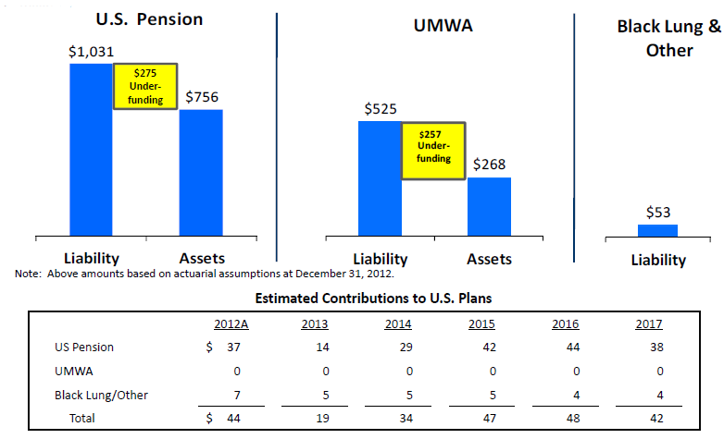
Pension Liabilities, Pt. IV
Source: S&P Capital IQ, Team’s Analysis

Slide 66
Pension Liabilities, Pt. V
Source: S&P Capital IQ, Team’s Analysis

Slide 67
OPEB, Pt. I
For the Fiscal Period Ending | 12 months Dec-31-2007 | 12 months Dec-31-2008 | 12 months Dec-31-2009 | 12 months Dec-31-2010 | 12 months Dec-31-2011
OPEB Information - Total
Defined Benefit Net Periodic Cost
Def. Benefit Service Cost | 0.2 | 0.1 | - | - | -
Def. Benefit Interest Cost | 34.8 | 34.3 | 28.6 | 30.0 | 26.8
Def. Benefit Expected Return on Assets | (38.6) | (38.6) | (22.6) | (25.3) | (25.5)
Def. Benefit Other Cost | 12.0 | 6.2 | 16.8 | 17.8 | 17.3
Def. Benefit Total Cost | 8.4 | 2.0 | 22.8 | 22.5 | 18.6
Total OPEB Expense | 8.4 | 2.0 | 22.8 | 22.5 | 18.6
Defined Benefit Obligation
Beg. Def. Benefit Obligation | 632.5 | 570.6 | 532.2 | 512.6 | 536.5
Def. Benefit Service Cost | 0.2 | 0.1 | - | - | -
Def. Benefit Interest Cost | 34.8 | 34.4 | 28.6 | 30.0 | 26.8
Def. Benefit Actuarial Gain/Losses | (56.3) | (27.6) | (3.0) | 15.0 | 69.9
Def. Benefits Paid | (41.3) | (41.5) | (44.0) | (40.5) | (42.7)
Foreign Exchange Adj. | 0.8 | - | - | - | -
Other Adj. To Def. Benefit Obligation | (0.1) | (3.8) | (1.2) | 19.4 | -
Proj. Benefit Obligation | 570.6 | 532.2 | 512.6 | 536.5 | 590.5
Accum. Benefit Obligation | 570.6 | 532.2 | 512.6 | 536.5 | 590.5
Plan Assets
Beg. Plan Assets | 459.3 | 460.3 | 276.1 | 308.0 | 310.2
Actual Return on Plan Assets | 35.1 | (149.7) | 67.8 | 37.1 | (5.1)
Employer Contributions | 7.2 | 7.1 | 7.6 | 5.9 | 7.0
Benefits Paid | (41.3) | (41.6) | (43.5) | (40.8) | (44.1)
Total Plan Assets | 460.3 | 276.1 | 308.0 | 310.2 | 268.0
Source: S&P Capital IQ, Team’s Analysis

Slide 68
OPEB, Pt. II
For the Fiscal Period Ending | 12 months Dec-31-2007 | 12 months Dec-31-2008 | 12 months Dec-31-2009 | 12 months Dec-31-2010 | 12 months Dec-31-2011
Weighted Avg. Assumptions on Net Periodic Cost
Net Periodic Cost Disc. Rate - Min | 5.8% | 6.4% | 6.2% | 5.8% | 5.2%
Net Periodic Cost Disc. Rate - Max | 5.8% | 6.4% | 6.2% | 5.8% | 5.2%
Exp. Long-Term Rate of Return on Assets - Min | 8.8% | 8.8% | 8.8% | 8.8% | 8.8%
Exp. Long-Term Rate of Return on Assets - Max | 8.8% | 8.8% | 8.8% | 8.8% | 8.8%
Breakdown of Plan Assets
Plan Assets - Equities (%) | 69.0% | - | 63.0% | 62.0% | 60.0%
Plan Assets - Fixed Income (%) | 31.0% | - | 24.0% | 25.0% | 25.0%
Other Plan Assets (%) | - | - | 13.0% | 13.0% | 15.0%
Breakdown of Plan Assets
Plan Assets - Equities | 317.6 | - | 194.0 | 192.3 | 160.8
Plan Assets - Fixed Income | 142.7 | - | 73.9 | 77.6 | 67.0
Other Plan Assets | - | - | 40.0 | 40.3 | 40.2
Weighted Avg. Assumptions on Def. Benefit Obligation
PBO Assumed Rate of Return - Min | 6.4% | 6.2% | 5.9% | 5.2% | 4.4%
PBO Assumed Rate of Return - Max | 6.4% | 6.2% | 5.9% | 5.2% | 4.4%
Estimated Future Benefits Paid
Est. Future Benefits Paid - 1st Yr. | 43.3 | 43.5 | 42.7 | 44.3 | 44.1
Est. Future Benefits Paid - 2nd Yr. | 45.1 | 43.4 | 43.2 | 44.3 | 43.3
Est. Future Benefits Paid - 3rd Yr. | 46.1 | 44.1 | 43.2 | 44.4 | 42.9
Est. Future Benefits Paid - 4th Yr. | 47.0 | 44.0 | 43.3 | 43.6 | 42.7
Est. Future Benefits Paid - 5th Yr. | 47.1 | 44.2 | 42.5 | 43.2 | 41.9
Est. Future Benefits Paid - Thereafter | 226.6 | 207.6 | 198.2 | 200.2 | 194.3
Source: S&P Capital IQ, Team’s Analysis

Slide 69
OPEB, Pt. III
For the Fiscal Period Ending | 12 months Dec-31-2007 | 12 months Dec-31-2008 | 12 months Dec-31-2009 | 12 months Dec-31-2010 | 12 months Dec-31-2011
Balance Sheet Reconciliation Items
Accrued Benefit Liability | (6.0) | (6.2) | (6.3) | (7.7) | (7.1)
Adj. for Liability Recognized on Balance Sheet
Net Asset/Liability Recognized on Balance Sheet | (110.3) | (256.1) | (204.6) | (226.3) | (322.5)
Benefits Sensitivity Analysis
1% Increase - Effect on Service and Interest Cost | - | - | - | - | 2.5
1% Increase - Effect on PBO | - | - | - | - | 60.1
1% Decrease - Effect on Service and Interest Cost | - | - | - | - | (2.1)
1% Decrease - Effect on PBO | - | - | - | - | (51.1)
Other Compr. Income Components Recognized on the BS
Net Actuarial Loss/Gain | 173.7 | 326.2 | 260.9 | 247.7 | 332.9
Prior Service Cost/Benefit | (1.8) | (2.9) | (2.6) | 15.3 | 13.3
Net Amount Recognized | 171.9 | 323.3 | 258.3 | 263.0 | 346.2
Consolidated Balance Sheet Amounts
Current Liabilities | (6.0) | (6.2) | (6.3) | (7.7) | (7.1)
Long Term Liabilities | (104.3) | (249.9) | (198.3) | (218.6) | (315.4)
Net Periodic Benefit Cost to be Recognized in the Subsequent Period
Prior Service Cost/Benefit | (0.2) | (0.3) | (0.3) | 2.0 | 2.0
Net Actuarial Loss/Gain | 9.0 | 20.3 | 16.3 | 15.4 | 22.4
Total Amount to be Recognized | 8.8 | 20.0 | 16.0 | 17.4 | 24.4
Other Post-Retirement Benefit Related Items
Benefit Info Date | Dec-31-2007 | Dec-31-2008 | Dec-31-2009 | Dec-31-2010 | Dec-31-2011
Source: S&P Capital IQ, Team’s Analysis

Slide 70
Pension Projections Funded Status
(In millions) | Primary U.S. Pension Plan | Other U.S. Pension Plan | UMWA Plans | Black Lung and Other Plans | Total | U.S. Pension Plans | UMWA Plans | Black Lung and Other Plans | Total
Actual payments
2008 | $ - | 1.9 | - | 7.1 | 9.0 | (329.2) | (207.5) | (48.6) | (585.3)
2009 | 150.0 | 4.2 | 0.5 | 7.6 | 162.3 | (152.3) | (157.5) | (47.1) | (356.9)
2010 | - | 0.8 | - | 5.9 | 6.7 | (191.7) | (164.1) | (62.2) | (418.0)
2011 | - | 0.7 | - | 7.0 | 7.7 | (305.3) | (261.6) | (60.9) | (627.8)
Projected payments 2012 | 31.5 | 13.2 | - | 7.2 | 51.9 | (248.5) | (262.9) | (56.1) | (567.5)
2013 | 41.5 | 2.4 | - | 5.8 | 49.7 | (188.3) | (264.9) | (52.6) | (505.8)
2014 | 51.1 | 0.8 | - | 5.5 | 57.4 | (114.9) | (267.7) | (49.2) | (431.8)
2015 | 47.0 | 0.8 | - | 5.2 | 53.0 | (39.6) | (271.5) | (46.0) | (357.1)
2016 | 42.4 | 0.8 | - | 5.0 | 48.2 | 37.0 | (276.2) | (42.9) | (282.1)
2017 | 14.7 | 0.8 | - | 4.6 | 20.1 | 90.9 | (282.0) | (39.9) | (231.0)
2018 | 0.2 | 0.8 | - | 4.4 | 5.4 | 133.6 | (289.1) | (36.8) | (192.3)
2019 | - | 0.8 | - | 4.2 | 5.0 | 179.1 | (297.5) | (33.7) | (152.1)
2020 | - | 1.4 | - | 3.9 | 5.3 | 228.6 | (307.5) | (30.7) | (109.6)
2021 | - | 0.9 | - | 3.6 | 4.5 | 281.0 | (319.0) | (28.3) | (66.3)
2022 | - | 0.7 | - | 3.4 | 4.1 | 337.0 | (332.2) | (25.5) | (20.7)
2023 | - | 0.7 | 26.4 | 3.2 | 30.3 | 396.8 | (320.0) | (23.4) | 53.4
2024 | - | 0.7 | 29.4 | 3.0 | 33.1 | 460.8 | (304.0) | (21.3) | 135.5
2025 | - | 0.7 | 28.4 | 2.8 | 31.9 | 529.3 | (288.4) | (19.4) | 221.5
2026 | - | 0.7 | 27.2 | 2.6 | 30.5 | 602.4 | (273.3) | (17.6) | 311.5
2027 | - | 0.6 | 26.3 | 2.4 | 29.3 | 680.6 | (258.4) | (15.9) | 406.3
2028 | - | 0.6 | 25.6 | 2.2 | 28.4 | 764.3 | (243.7) | (14.3) | 506.3
2029 | - | 0.6 | 24.8 | 2.0 | 27.4 | 853.8 | (229.1) | (12.8) | 611.9
2030 | - | 0.5 | 23.9 | 1.8 | 26.2 | 949.6 | (214.8) | (11.5) | 723.3
Source: Brink’s 2011 10k

Slide 71
Assumptions
Assumptions | Actual |  |  |  |  | Estimated
 | 2007 | 2008 | 2009 | 2010 | 2011 | 2012E | 2013E | 2014E | 2015E | 2016E | 2017E
Income Statement
% Growth Revenue | 16.2% | 15.7% | -0.9% | -0.4% | 24.5% | 0.8% | 8.0% | 7.0% | 6.0% | 5.0% | 4.0%
Gross Margin | 19.7% | 20.8% | 19.2% | 18.7% | 18.3% | 18.6% | 18.7% | 18.7% | 18.7% | 18.7% | 18.7%
Average Life of LT Assets (Years) | 11.7 | 4.9 | 4.5 | 5.6 | 5.1 | 5.0 | 5.0 | 5.0 | 5.0 | 5.0 | 5.0
Income Tax Rate | 37.0% | 23.6% | -36.7% | 48.1% | 38.0% | 23.8% | 35.0% | 35.0% | 35.0% | 35.0% | 35.0%
Minority Int. in Earnings | -22.8 | -39.8 | -31.7 | -15.7 | -24.0 | -21.8 | -21.8 | -21.8 | -21.8 | -21.8 | -21.8
SGA % of sales | 13.9% | 13.7% | 13.7% | 13.8% | 14.0% | 14.6% | 14.4% | 14.3% | 14.2% | 14.1% | 14.0%
Other Operating Expense/(Income) | -5.2 | -6.5 | -11.8 | -12.1 | -4.8 | -5.0 | -5.0 | -5.0 | -5.0 | -5.0 | -5.0
Int Exp % of Revenue | 0.08% | 0.09% | 0.02% | 0.34% | 0.47% | 0.44% | 0.45% | 0.40% | 0.35% | 0.30% | 0.25%
Statement of Cash Flows
Cap-Ex as % of Net PPE | 12.7% | 31.0% | 31.0% | 21.3% | 26.2% | 25.6% | 25.0% | 25.0% | 25.0% | 25.0% | 25.0%
Other Amortization | 14.1 | 14.2 | 13.6 | 12.8 | 15.9 | 0.0 | 15.9 | 15.9 | 15.9 | 15.9 | 15.9
Dividends as % of Net Income | 12.0% | 9.9% | 9.2% | 33.1% | 25.1% | 24.4% | 25.0% | 25.0% | 25.0% | 25.0% | 25.0%
Special Dividend Paid | 0.0 | 0.0 | 0.0 | 0.0 | 0.0 | 0.0 | 0.0 | 0.0 | 0.0 | 0.0 | 0.0
Foreign Exchange Rate Adj. ($M) | 8.1 | -13.1 | -15.4 | 0.1 | -8.1 | -13.6 | 0.0 | 0.0 | 0.0 | 0.0 | 0.0
Source: Team’s Analysis
Notes:
Show DCF Income Statement Assumptions slide
Nick: Now I will go into our assumptions for the DCF model. Looking at the income statement, our revenue growth assumptions were derived from the industry-wide expectation of decreasing growth. We assumed 2013 revenue growth to be 8 percent, which was the 5-year average, and then to grow a declining rate of 1 percent per year, given previous volatility of Brink’s revenue.
As for the cost of goods sold, even though management has set goals to control costs, costs of goods sold as a percentage of revenue has increased since 2008, so we held cost of goods at 81.27 percent of revenue, which was the 3-year average of 2009 through 2011.
We believe that Brink’s cost cutting goals will however allow them to reduce selling, general, and administrative expenses, so we stepped down SG&A as a percentage of revenue by a tenth of a percent each year from our 2012 estimate of 14.5 percent of revenue.
We assumed the income tax rate will be 35% for the next five years. This is supported by a 36% 5-year average of the effective tax rate excluding 2009, which had an extraordinary tax credit.

Slide 72
Assumptions, Pt. II
Assumptions | Actual |  |  |  |  | Estimated
 | 2007 | 2008 | 2009 | 2010 | 2011 | 2012E | 2013E | 2014E | 2015E | 2016E | 2017E
Balance Sheet
Cash & ST Investments as % of sales | 7.2% | 7.9% | 4.6% | 5.9% | 4.7% |  | 5.0% | 5.0% | 5.0% | 5.0% | 5.0%
Accounts Receivable (AR) Turnover | 5.6 | 7.0 | 7.3 | 5.9 | 7.1 |  | 6.5 | 6.5 | 6.5 | 6.5 | 6.5
Days Prepaid Outstanding (DPO) | 12.5 | 11.5 | 9.4 | 14.1 | 12.6 |  | 12.0 | 12.0 | 12.0 | 12.0 | 12.0
Days Other Outstanding (DOO) | 8.5 | 3.6 | 4.5 | 5.6 | 6.3 |  | 5.0 | 5.0 | 5.0 | 5.0 | 5.0
PPE (Net) as % of sales | 40.9% | 16.9% | 17.5% | 22.4% | 19.3% |  | 20.0% | 20.0% | 20.0% | 20.0% | 20.0%
Investments as % of sales | 2.5% | 1.8% | 1.8% | 1.3% | 0.6% |  | 1.0% | 1.0% | 1.0% | 1.0% | 1.0%
Intangibles as % of sales | 0.9% | 0.7% | 2.2% | 2.7% | 1.6% |  | 1.6% | 1.6% | 1.6% | 1.6% | 1.6%
Other LTA as % of sales | 7.2% | 7.3% | 9.6% | 10.4% | 10.5% |  | 10.0% | 10.0% | 10.0% | 10.0% | 10.0%
Goodwill | 141.3 | 139.6 | 213.7 | 244.3 | 231.4 | 231.8 | 242.0 | 242.0 | 242.0 | 242.0 | 242.0
Days Payable Outstanding (DPO) | 28.6 | 20.1 | 18.3 | 20.4 | 18.3 |  | 20.0 | 20.0 | 20.0 | 20.0 | 20.0
Accrued Expenses as % of sales | 14.3% | 11.4% | 11.6% | 13.2% | 11.5% |  | 12.0% | 12.0% | 12.0% | 12.0% | 12.0%
Income Taxes Payable as % of sales | 0.4% | 0.5% | 0.1% | 0.3% | 0.3% |  | 0.3% | 0.3% | 0.3% | 0.3% | 0.3%
Other Current Liabilities as % of sales | 0.0% | 0.0% | 0.0% | 1.2% | 0.6% |  | 1.0% | 1.0% | 1.0% | 1.0% | 1.0%
Current financial liabilities, % of total debt | 31.1% | 9.0% | 13.5% | 20.2% | 20.7% |  | 20.0% | 19.5% | 19.0% | 18.5% | 18.0%
Total Debt as % of Total Assets | 4.1% | 10.4% | 10.4% | 17.1% | 13.1% |  | 14.5% | 13.4% | 12.3% | 11.1% | 10.0%
Other Long-term liabilities as % of sales | 6.6% | 5.0% | 5.4% | 5.5% | 4.6% |  | 4.4% | 4.2% | 4.7% | 4.9% | 4.8%
Unearned Revenue, Current | 39.6 | 0.0 | 0.0 | 0.0 | 0.0 | 0.0 | 0.0 | 0.0 | 0.0 | 0.0 | 0.0
Capital Leases | 13.9 | 0.0 | 0.0 | 0.0 | 73.8 | 0.0 | 0.0 | 0.0 | 0.0 | 0.0 | 0.0
Unearned Revenue, Non-Current | 178.6 | 0.0 | 0.0 | 0.0 | 0.0 | 0.0 | 0.0 | 0.0 | 0.0 | 0.0 | 0.0
Pension & Other Post-Retire. Benefits | 162.3 | 623.3 | 390.4 | 485.4 | 685.0 | 617.5 | 555.8 | 481.8 | 407.1 | 332.1 | 281.0
Def. Tax Liability, Non-Curr. | 29.8 | 21.5 | 30.5 | 30.6 | 23.0 | 21.9 | 31.0 | 31.0 | 31.0 | 31.0 | 31.0
Common Stock | 48.4 | 45.7 | 47.9 | 46.4 | 46.9 | 47.7 | 48.0 | 48.0 | 48.0 | 48.0 | 48.0
Additional Paid In Capital | 452.6 | 486.3 | 550.2 | 542.6 | 559.5 | 574.1 | 568.3 | 568.3 | 568.3 | 568.3 | 568.3
Comprehensive Inc. and Other | -130.5 | -628.0 | -578.0 | -610.3 | -787.9 | -948.7 | -634.7 | -510.7 | -436.0 | -361.0 | -309.9
Minority Interest | 68.2 | 91.3 | 60.9 | 66.9 | 74.4 | 81.1 | 74.9 | 74.9 | 74.9 | 74.9 | 74.9
Source: Team’s Analysis
Notes:
Nick: Moving to the balance sheet, we held cash as a percentage of revenue constant at 5%, as the historical volatility was low with a standard deviation of 1.49%.
As for debt, Brink’s has taken on additional debt in recent years, but management has plans to reduce debt, so we assumed debt as a percentage of assets would return to pre-recession levels. To reflect this assumption, we stepped this ratio down over five years from current levels toward levels seen before 2008.
We selected a 4% terminal growth rate for our DCF, which is inline with long-term GDP growth rates. We believe the accurately reflects Brink’s terminal growth prospects because of the maturity of the industry.

Slide 73
2012 Estimate Calculation
Source: Team’s Analysis

Slide 74
Economic Value Added (EVA)
 | 2007 | 2008 | 2009 | 2010 | 2011 | 2012 | 2013 | 2014 | 2015 | 2016 | 2017
Pre-Tax Income (EBT) | $160.70 | $224.60 | $166.30 | $139.60 | $156.40 | $136.80 | $169.20 | $187.49 | $205.63 | $223.23 | $239.82
Add: Interest Expense (Income) | -2.1 | 3.0 | -0.5 | -10.7 | -18.1 | -17.1 | -19.0 | -18.1 | -16.8 | -15.1 | -13.1
Less: Taxes on adjusted operating income | -58.7 | -53.7 | 60.9 | -62.0 | -52.5 | -28.5 | -52.6 | -59.3 | -66.1 | -72.8 | -79.3
NOPLAT | 99.9 | 173.9 | 226.7 | 66.9 | 85.8 | 91.2 | 97.6 | 110.1 | 122.7 | 135.3 | 147.4
Total Assets | 2394.3 | 1815.8 | 1879.8 | 2270.5 | 2406.2 | 2544.6 | 2681.4 | 2852.1 | 3008.7 | 3147.1 | 3263.3
Less: Accounts Payable | 171.9 | 137.8 | 127.2 | 141.5 | 159.5 | 167.1 | 188.5 | 201.6 | 213.7 | 224.4 | 233.4
Less: Other Current Liabilities | 0.0 | 0.0 | 0.0 | 38.5 | 25.1 | 1.2 | 42.3 | 45.3 | 48.0 | 50.4 | 52.4
Invested Book Capital | 2222.4 | 1678.0 | 1752.6 | 2090.5 | 2221.6 | 2376.3 | 2450.6 | 2605.2 | 2747.0 | 2872.2 | 2977.5
Add: Interest Expense (Income) | -2.1 | 3.0 | -0.5 | -10.7 | -18.1 | -17.1 | -19.0 | -18.1 | -16.8 | -15.1 | -13.1
Less: Taxes on adjusted operating income | -58.7 | -53.7 | 60.9 | -62.0 | -52.5 | -28.5 | -52.6 | -59.3 | -66.1 | -72.8 | -79.3
Invested Capital | 2161.6 | 1627.3 | 1813.0 | 2017.8 | 2151.0 | 2330.7 | 2379.0 | 2527.8 | 2664.1 | 2784.3 | 2885.0
WACC | 11% | 11% | 11% | 11% | 11% | 11% | 11% | 11% | 11% | 11% | 11%
Economic Earnings (EVA) | -127.1 | -5.1 | 27.3 | -155.0 | -150.8 | -165.2 | -261.7 | -278.1 | -293.1 | -306.3 | -317.4
Source: Team’s Analysis

Slide 75
Free Cash Flow (FCF) Calculation
 |  | 2013E | 2014E | 2015E | 2016E | 2017E
Pre-Tax Income (EBT) |  | $ 169.20 | $ 187.49 | $ 205.63 | $ 223.23 | $ 239.82
Add: Interest Expense (Income) |  | (19.04) | (18.11) | (16.80) | (15.12) | (13.10)
Less: Taxes on adjusted operating income |  | (52.55) | (59.28) | (66.09) | (72.84) | (79.35)
NOPLAT |  | 97.60 | 110.09 | 122.74 | 135.27 | 147.36
Add: Depreciation |  | 169.28 | 181.13 | 191.99 | 201.59 | 209.66
Gross Cash Flow |  | 266.88 | 291.22 | 314.74 | 336.86 | 357.02
Change in Working Capital |  | (32.75) | 25.11 | 49.41 | 47.17 | 43.70
Capital Expenditures |  | (211.60) | (226.41) | (239.99) | (251.99) | (262.07)
Cash From (Used For) Gross Investment |  | (244.35) | (201.30) | (190.58) | (204.82) | (218.37)
Free Cash Flow |  | 22.53 | 89.92 | 124.16 | 132.04 | 138.65
Source: Team’s Analysis

Slide 76
Perpetuity Growth Model
Free Cash Flow |  | 22.53 | 89.92 | 124.16 | 132.04 | 138.65
WACC |  | 11.0% | 11.0% | 11.0% | 11.0% | 11.0%
Terminal Growth Rate |  |  |  |  |  | 4%
Continuing Value |  |  |  |  |  | 1,980.67
Periods Discounted |  | 1.00 | 2.00 | 3.00 | 4.00 | 5.00
Discounted Cash Flow |  | 20.30 | 72.98 | 90.78 | 86.98 | 1,175.43
Sum of DCF |  |  |  |  |  | 1,446.47
Mid Year Adjustment |  |  |  |  |  | 40.07
Implied Enterprise Value |  |  |  |  |  | 1,486.54
add: Cash & Short-term Investments |  |  |  |  |  | 170.31
less: value of debt |  |  |  |  |  | 328.17
less: Value of minority interest |  |  |  |  |  | 81.09
Implied Equity Value |  |  |  |  |  | 1,247.60
Shares Outstanding |  |  |  |  |  | 47.80
Implied Share Price |  |  |  |  |  | $ 26.10
Source: Team’s Analysis

Slide 77
DCF Sensitivity Analysis
 |  | Terminal WACC
 |  | 9.50% | 10.00% | 10.50% | 11.00% | 11.50% | 12.00% | 12.50%
Terminal Growth rate | 2.00% | 26.08 | 23.99 | 22.17 | 20.56 | 19.13 | 17.85 | 16.70
 | 2.50% | 27.86 | 25.52 | 23.48 | 21.70 | 20.12 | 18.73 | 17.48
 | 3.00% | 29.91 | 27.25 | 24.97 | 22.98 | 21.24 | 19.70 | 18.34
 | 3.50% | 32.30 | 29.26 | 26.67 | 24.44 | 22.50 | 20.80 | 19.30
 | 4.00% | 35.13 | 31.60 | 28.63 | 26.10 | 23.92 | 22.03 | 20.36
 | 4.50% | 38.52 | 34.36 | 30.92 | 28.02 | 25.55 | 23.42 | 21.57
 | 5.00% | 42.66 | 37.68 | 33.62 | 30.25 | 27.42 | 25.01 | 22.93
Source: Team’s Analysis

Slide 78
P/E Valuation
2013E P/E Valuation
Forward P/E | 13.42x
EPS | $1.85
Implied Price | $24.78
Source: Team’s Analysis

Slide 79
Free Cash Flow (FCF) Yield
 |  | 2007 | 2008 | 2009 | 2010 | 2011 | LTM 2012 | 2012E
Brink's | Free Cash Flow | $311.90 | $261.80 | $24.60 | $86.50 | $50.80 |  | $8.20
 | FCF Yield | 9.45% | 25.59% | 2.03% | 6.02% | 3.53% |  | 0.57%
 | % Change | - | 16.14% | -23.56% | 3.99% | -2.49% |  | -2.96%
G4S | Free Cash Flow | $311.65 | $289.25 | $520.13 | $420.01 | $309.73 | $362.36
 | FCF Yield | 5.35% | 8.35% | 9.10% | 7.19% | 4.99% | 5.93%
 | % Change | - | 3.00% | 0.75% | -1.91% | -2.20% | 0.93%
Garda | Free Cash Flow | $8.63 | $43.91 | $23.61 | $64.49 | $61.52 | $63.15
 | FCF Yield | 1.43% | 9.51% | 27.55% | 22.07% | 17.33% | N/A
 | % Change | - | 8.08% | 18.04% | -5.47% | -4.75% | N/A
Loomis | Free Cash Flow | -$140.80 | -$27.32 | $73.60 | $85.44 | $53.14 | $68.16
 | FCF Yield |  | -4.51% | 8.18% | 7.34% | 5.25% | 6.02%
 | % Change | - | -4.51% | 12.68% | -0.84% | -2.08% | 0.77%
Prosegur | Free Cash Flow | $142.69 | $197.94 | $135.96 | $175.46 | $80.88 | $171.90
 | FCF Yield | 6.04% | 13.01% | 5.14% | 5.27% | 2.79% | 4.51%
 | % Change | - | 6.96% | -7.87% | 0.13% | -2.48% | 1.72%
Source: S&P Capital IQ, Team’s Analysis

Slide 80
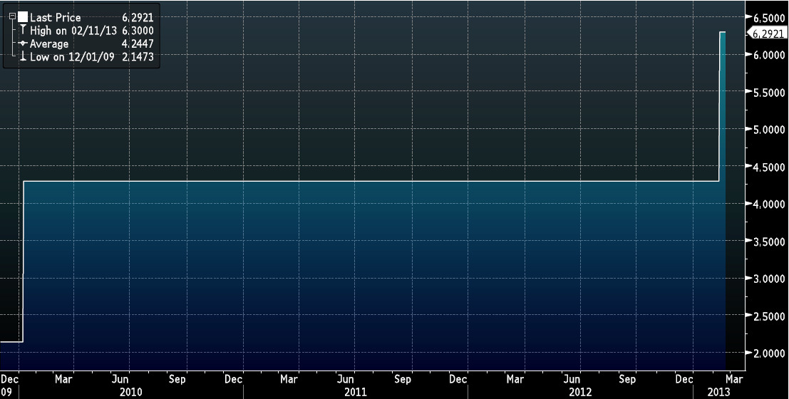
Currency Devaluation
USD VS. VEF
Source: Bloomberg

Slide 81
Historical & Projected Earnings
Source: Bloomberg

Slide 82
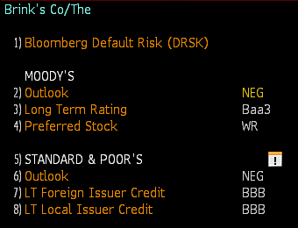
Credit Rating & Outlook
Source: Bloomberg

Slide 83
Frequently Asked Questions – 1
Can you elaborate on the Home Security spin off?
Brink’s Home Security (BHS) was spun-off on October 31, 2008. Brink’s distributed one share of BHS common stock for each share of Brink’s outstanding and contributed $50 million in cash at the time of the spin-off.
The business was later renamed Broadview Security.
In 2010, Tyco International, the holding company for ADT Worldwide Security, purchased Broadview Security for $42.50/share, which was 35 percent higher than Brink’s stock price at the time, $31.42.

Slide 84
Frequently Asked Questions -2a
Could you elaborate on the industry outlook?
Short-Run: the industry outlook is uncertain and subject to volatility
A linear regression of the S&P Security & Alarm Services index and the MSCI World index, an 83% correlation suggests that the industry is rather cyclical in nature. [See Linear Regression]
As long as broader macroeconomic risks continue to threaten the global economy industries which are cyclical such as the one Brink’s operates in will be subject to these same risks.

Slide 85
Frequently Asked Questions -2b
Could you elaborate on the industry outlook?
Long-Run: the industry is in decline as cash is gradually phased out due to an increase in the use non-cash instruments to conduct financial transactions.
According to the World Payments Report there is a fundamental transformation in the payments landscape which is expected to continue in the medium-to-longer term.
This has largely been due to regulatory pressure as there has been a drive towards increased standardization and commoditization
EXAMPLE:
Sweden has nearly eliminated the use of physical cash as it only comprises 3 percent of transactions in the entire country.
Public buses don’t accept cash
Offerings at church are made using credit or debit cards
A number of banks have stopped handling cash all together

Slide 86
Frequently Asked Questions – 3
Industry Risk
Segment Failure Risk: The possibility that one of Brink’s business segments could fail, such as an increase in the use of non-cash instruments reducing demand for the company’s Cash-In-Transit or Cash Logistics segment to the point that the segment is unprofitable
New Entrant Risk: The possibility that new competitors will enter the market and take market share from Brink’s by undercuting them or providing higher quality services for a comparable price.

Slide 87
Frequently Asked Questions – 4
Operational Risk
Theft of Customer Valuables: The possibility that cash or valuables that Brink’s is responsible for are stolen, as seen by the $50 million diamond heist that occurred in Brussels.
Disruption of IT Systems: The possibility of computer, phone, or IT systems going down jeopardizing Brink’s ability to carry out daily operations.
A decline in reputation: The possibility that customers and suppliers become less confident in Brink’s being able to carry out their services as has likely happened from the $50 million diamond heist that occured in Brussels.
Litigation risks from discontinued operations: The possibility that future lawsuits from past operations will materialize, such as a former coal employee suing Brink’s.

Slide 88
Frequently Asked Questions – 5 & 6
Regulatory Risks
Tax Regulation Risks: The possibility of a change in the corporate tax rate which reqiures Brink’s to pay out more in taxes, directly hindering profitability.
Industry Regulation Risks: The possibility of a change that requires Brink’s to devote resources to meet new industry standards, such as stricter environmental laws.
Financial Risks
Currency Exchange Risk: The possibility that major fluctuations in currency exchange rates will reduce Brink’s profitability.
Unfunded Liability Risk: The possibility that pension liabilities will become too large and jeopordize operating activities as cash is drained to meet these obligations.

Slide 89
Frequently Asked Questions – 7
Why did working capital increase in your estimate?
Based on our operating model assumptions, we believe that current assets will increase at a faster rate than current liabilities.

Slide 90
Frequently Asked Questions – 8
What have pension expenses been historically, and what do you expect they will be in the future?
See Pension slides
Management expectations indicate that pension obligations should decrease in the future and the company will make contributions totaling $228 million from 2012 through 2017.

Slide 91
Frequently Asked Questions – 9
What caused the spike in organic revenue growth in 2011?
We believe that the spike in organic revenue was due to a rebound in demand for Brink’s services since the 2008 downturn, as well as significant growth in Latin America.

Slide 92
Frequently Asked Questions – 10
Given that Brink’s is divesting less profitable businesses, how do you think this will affect their margins going forward?
If Brink’s continues to divest less profitable segments, margins should expand over time.
However, Brink’s has only divested small business in France and Poland
Until more systematic evalutions of all segments occurs, major improvments in margins may not be realized.

Slide 93
Frequently Asked Questions – 11
Why is your 2012 estimated tax rate only 23.8%?
The tax rate was calculated as funciton of our projections for 2012 operations.
Please refer to our calculation slide for 2012 estimates.

Slide 94
Frequently Asked Questions – 12
What is the source of the income from discontinued operations, and why has it stopped?
In 2007 and 2008, income from discontinued operations has primarily come from Brink’s spin-off of their home security segment
Other sources include BAX Global

Slide 95
Frequently Asked Questions – 13
Can you elaborate on Brink’s unfunded liabilities?
See Pension Projections Funded Status
Brink’s plans to be able to fully fund their liabilities by 2023

Slide 96
Frequently Asked Questions – 14
Why did you not include the Dividend Discount Model when generating your target price?
The stock price is highly sensitive to minor changes in the inputs.
For Example:
Decreasing the growth rate by 1 percent generates a price of $16.08
Increasing the growth rate by 1 percent generates a price of $59.47

Slide 97
Frequently Asked Questions – 16
What were your estimates for free cash flow going forward? Why were they increasing?
See FCF slide
Free cash flow is a funtion of our operating model assumptions. We assume positive revenue growth, constant margins, and decreasing SG&A, which leads to an increase in free cash flow in future years.

Slide 98
Frequently Asked Questions – 17
What was your terminal growth rate in your DCF?
We choose a terminal growth rate of 4% because we believe this is in line with long term GDP trends in developed nations.
Over half of Brink’s revenue was generated in developed nations which have been experiencing growth below 3% since the 2008 downturn.
Brink’s does operate in higher growth countries, but these countries’ growth will slow over time, and also carry more risk
As a result, we believe 4% for a terminal growth rate is generous for Brink’s and any higher rate could not be justified.

Slide 99
Frequently Asked Questions – 18
Why is Brink’s free cash flow yield the lowest among their competitors?
Brink’s low free cash flow yield is a result of their inability to control costs as seen by their decline in margins over the last few years.
In addition, FCF has also declined because the company is no longer recieving cash from discontinued operations.

Slide 100
Frequently Asked Questions – 20
Now that the market price for Brink’s has reached your target range, do you still believe the company is a sell?
Yes, we reaffirm our sell decision for the Brink’s company based on the following considerations:
The industry continues to have a challenging outlook in the future
Competition in the industry has continued to intensify
Brink’s management has yet to show an ability to control costs
Recent events such as the Diamond heist in Brussels have already impacted Q1 earnings
Given the opportunity to adust our operating model and valuations for these considerations we would likely lower our target price even further.

Slide 101
Thank You!
Virginia Commonwealth University
Nick DeRobertis | Corbin Fox | Kellie Masters | Chris Prompovitch

